Slide 2


Beginning
A Dynamic process focused on the needs of the support team friend

Slide 3

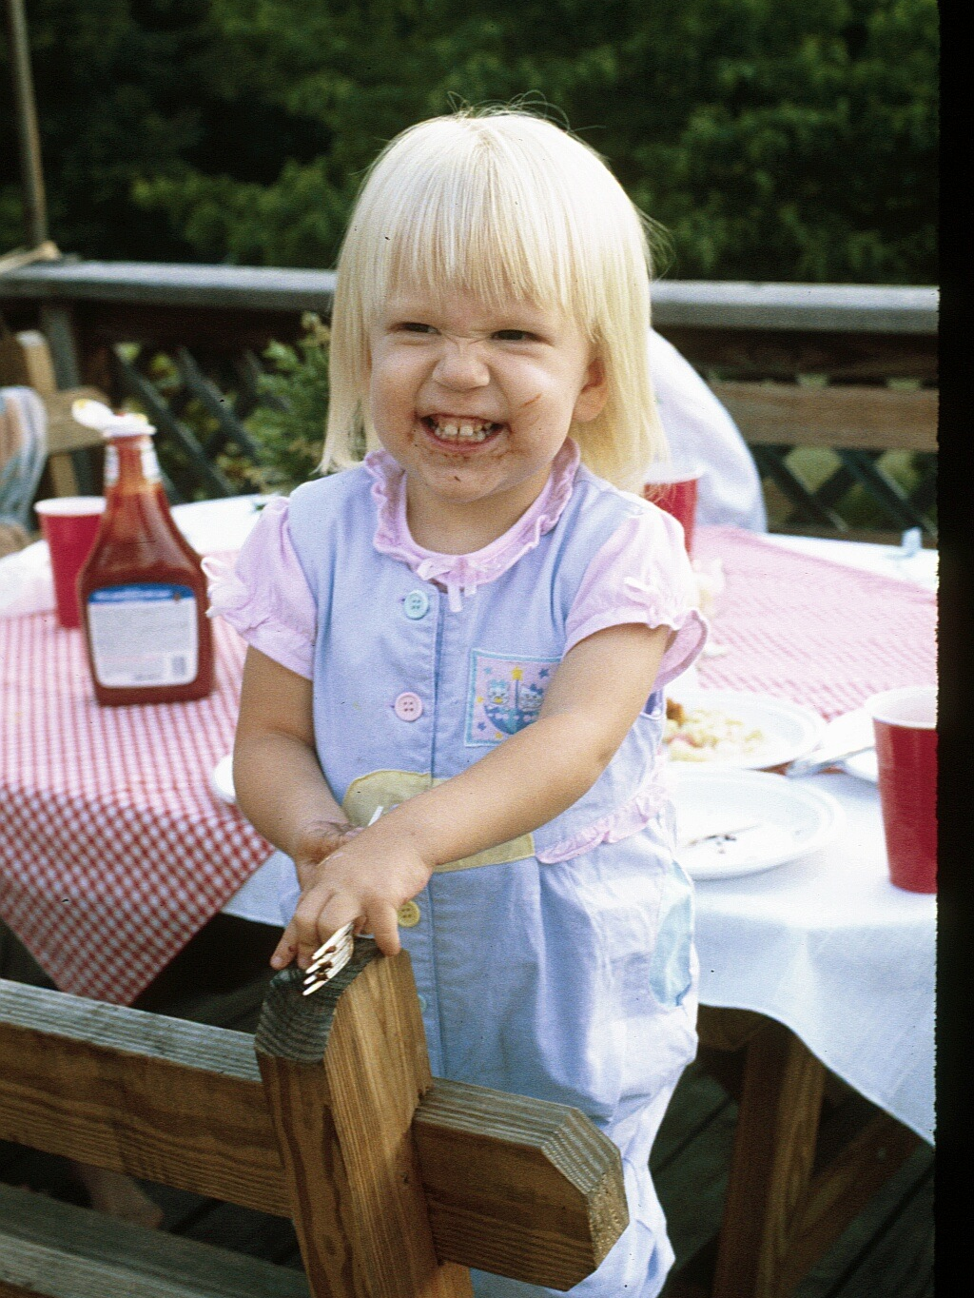

Beginning: Discover the need
YOu may know someone
your church decides on a team approach to ministry
a community organization or affinity group
a school or university

Slide 4
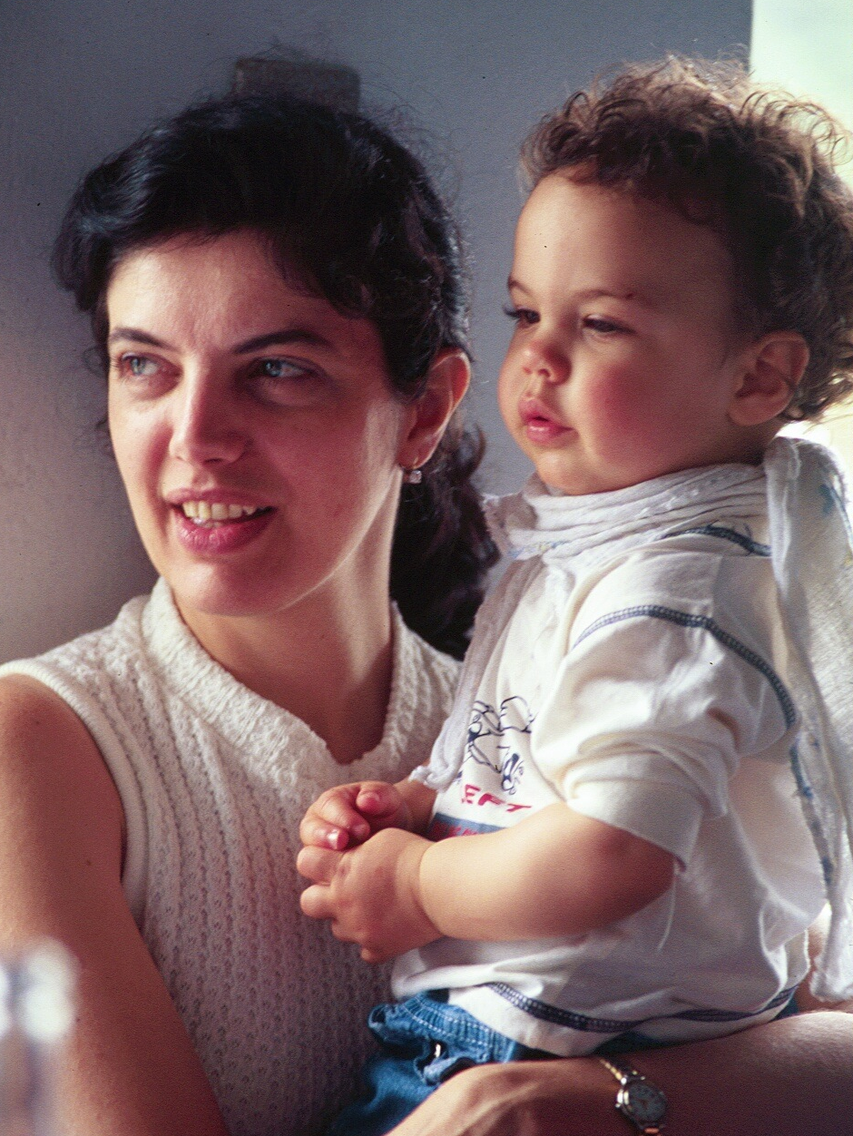
Beginning: Discover the response
How do people want to respond?
Not according to the admin’s agenda
According to the gifts, passions, loves of the care giver
matched to the needs of the friend

Slide 5
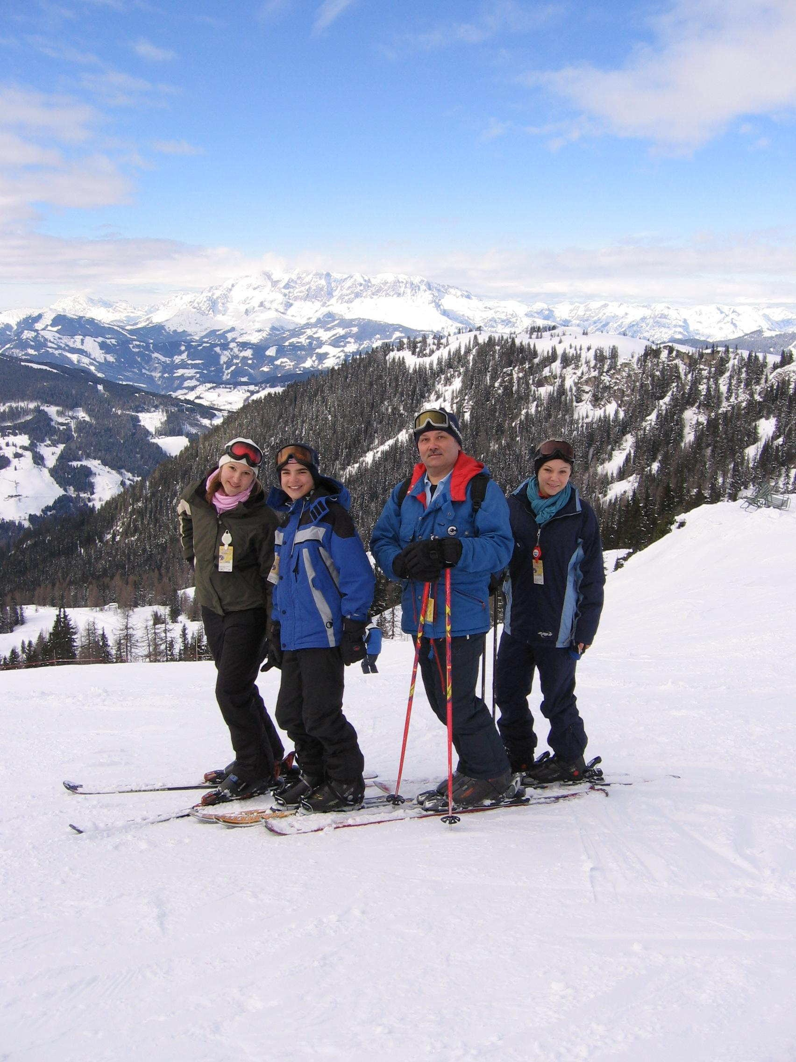
Beginning: Discover the team approach
Random acts of kindness tend to be uneven
a team uses an intentional focus
teams raise the effectiveness of their service
teams provide built-in support

Slide 6
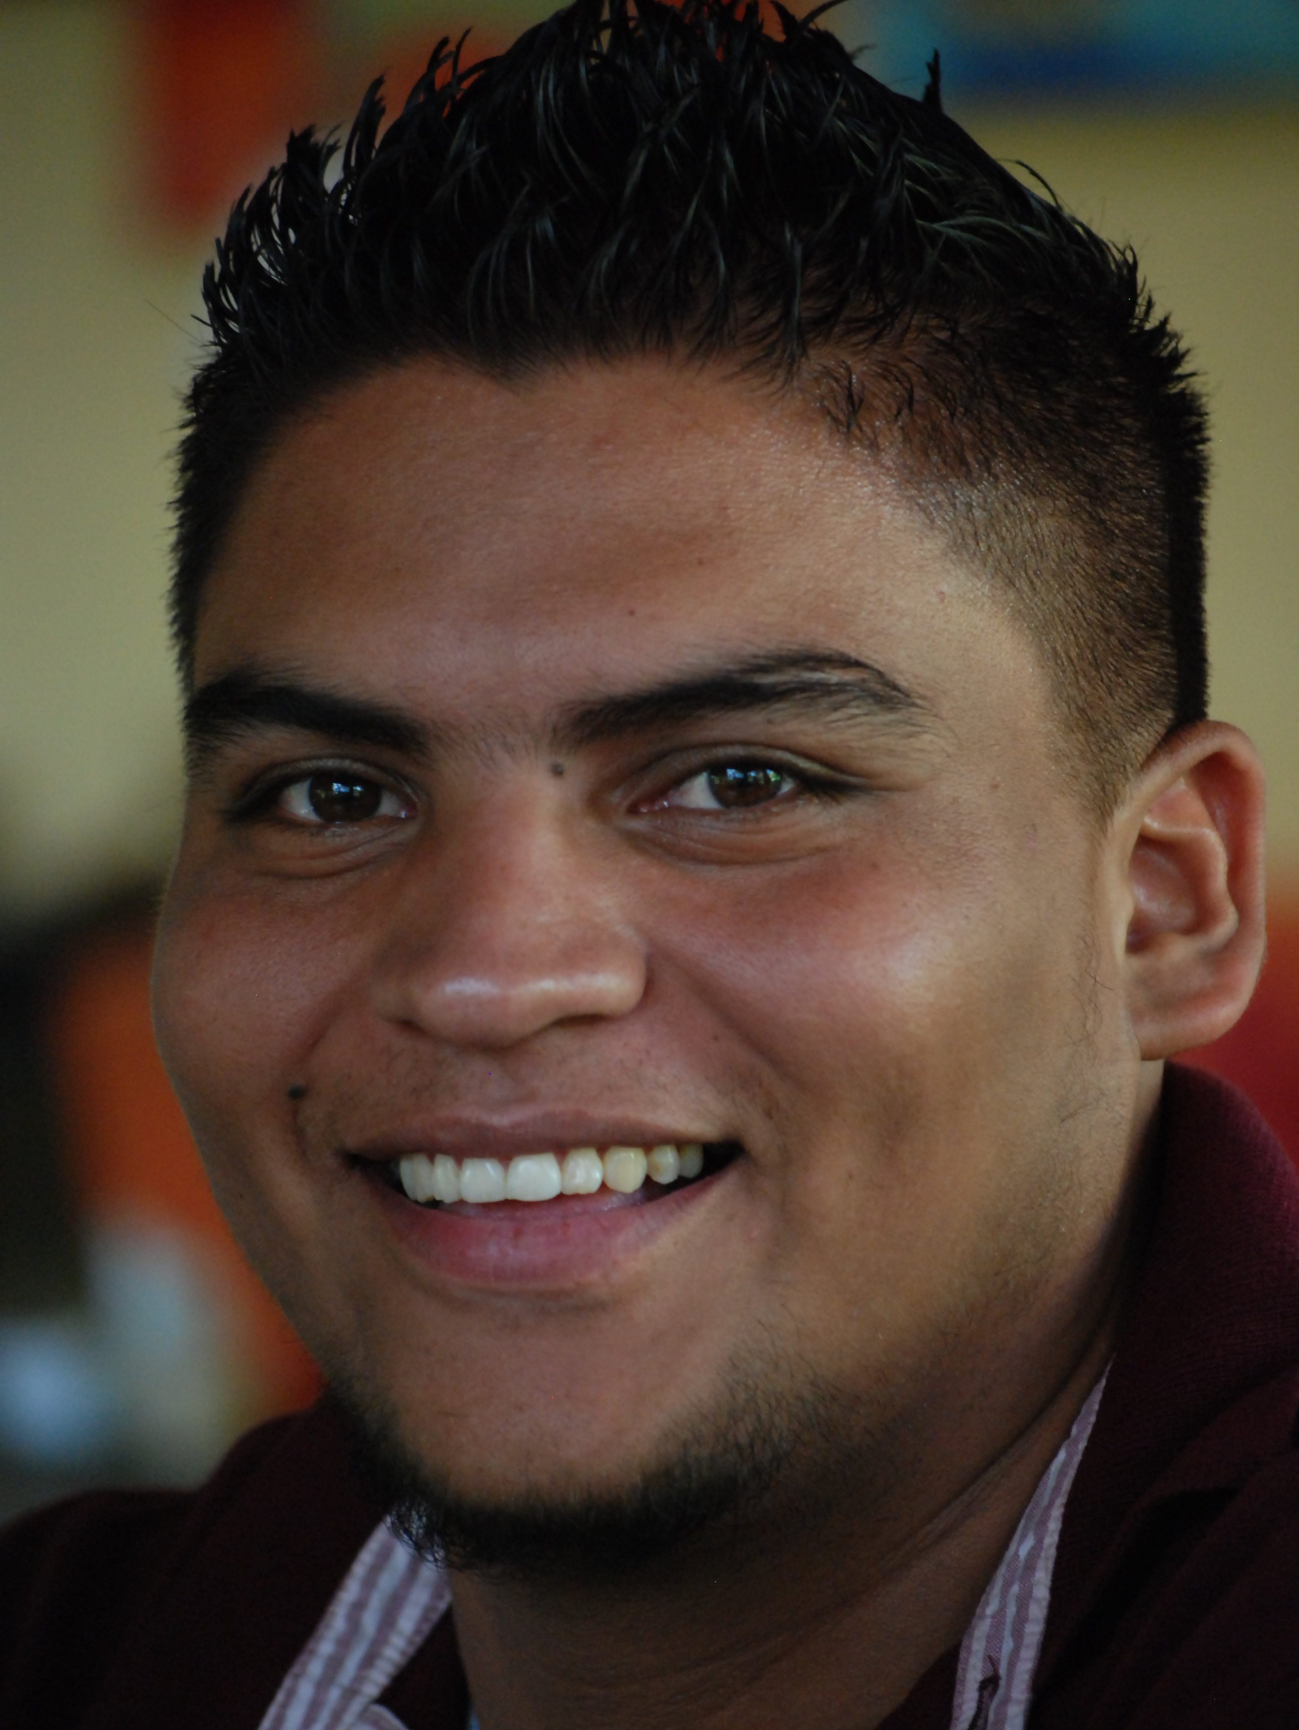
Beginning: Discover if a support team is appropriate
Follow-up visit to the friend
Need for team?
can volunteers meaningfully respond?
does the friend desire a team?

Slide 7
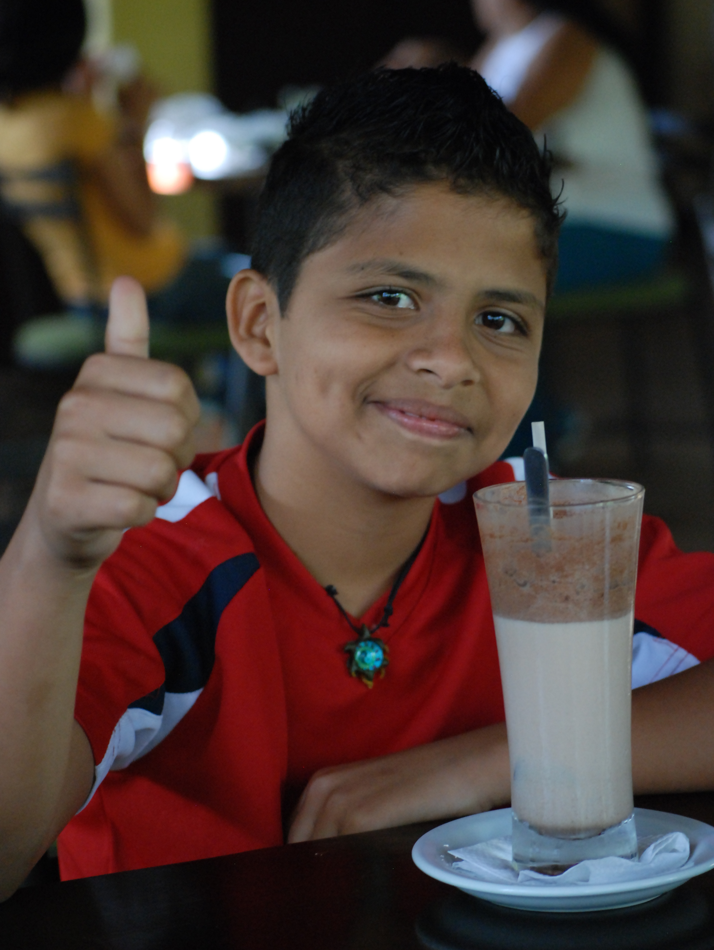
Beginning: discover the team leadership
identify and invite the person who will be the team leader
an organizer
“list keeper”
enjoys coordinating

Slide 8
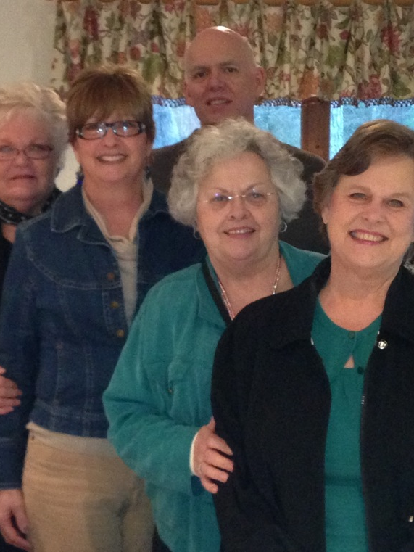
Beginning: discover the team leadership
Eventually, a team of persons can form whose task is to create multiple support teams
This “Initiative Team” seeks to form Teams throughout the organization

Slide 9
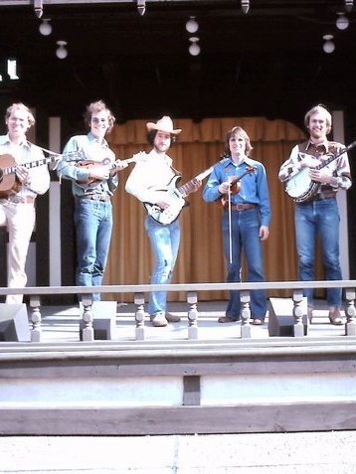
Opportunities for Discovery
Almost any occasion can provide the chance to help people “discover”
as little as a 15-minute introduction during a Sunday school class, staff meeting, or club gathering

Slide 10
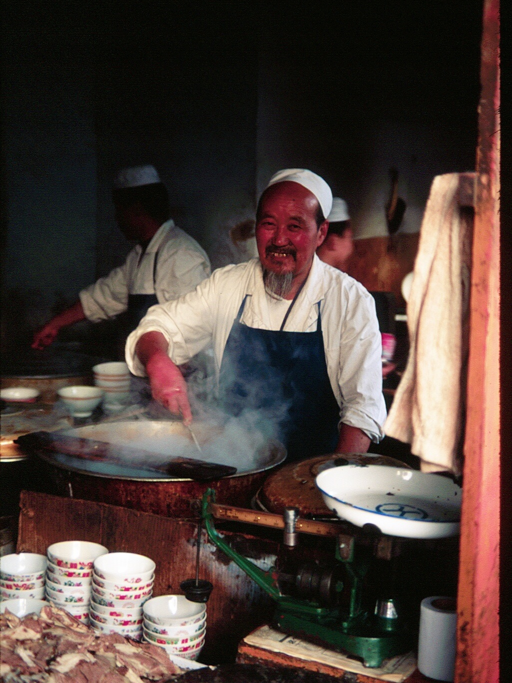
Opportunities for Discovery
Persons Consider:
  needs of those who are sick
  the team approach
  so they want to be on a team?
  record their responses

