Slide 2
Building
A Support Team is an ongoing, intentional model of caring.

Slide 3
Building Overview
Determine who will be on the team;
Provide basic training and orientation;
Organize the team for the work of caring.

Slide 4

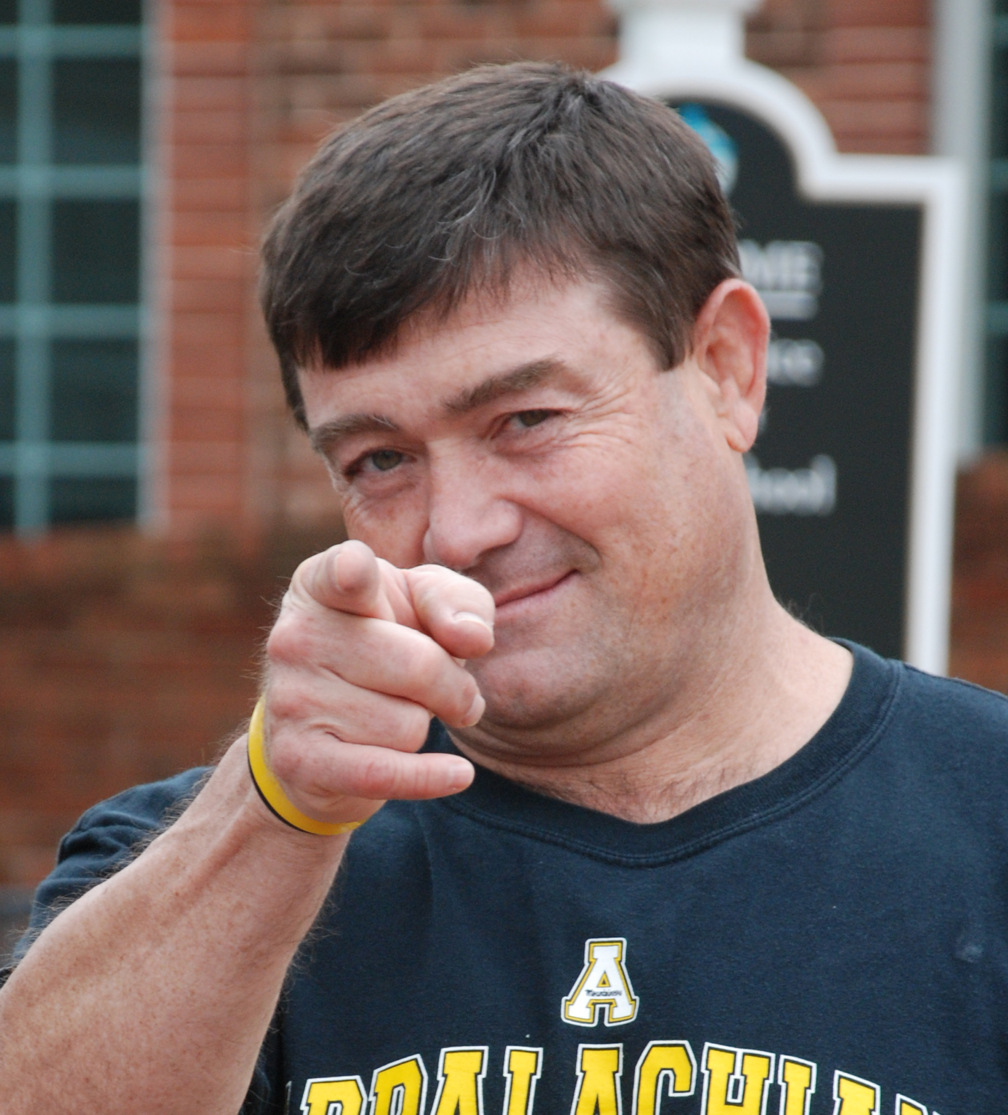
Building Overview
Determine who will be on the team;
  Persons who have agreed to be on the team and . . .
  agreed to work as a team.

Slide 5
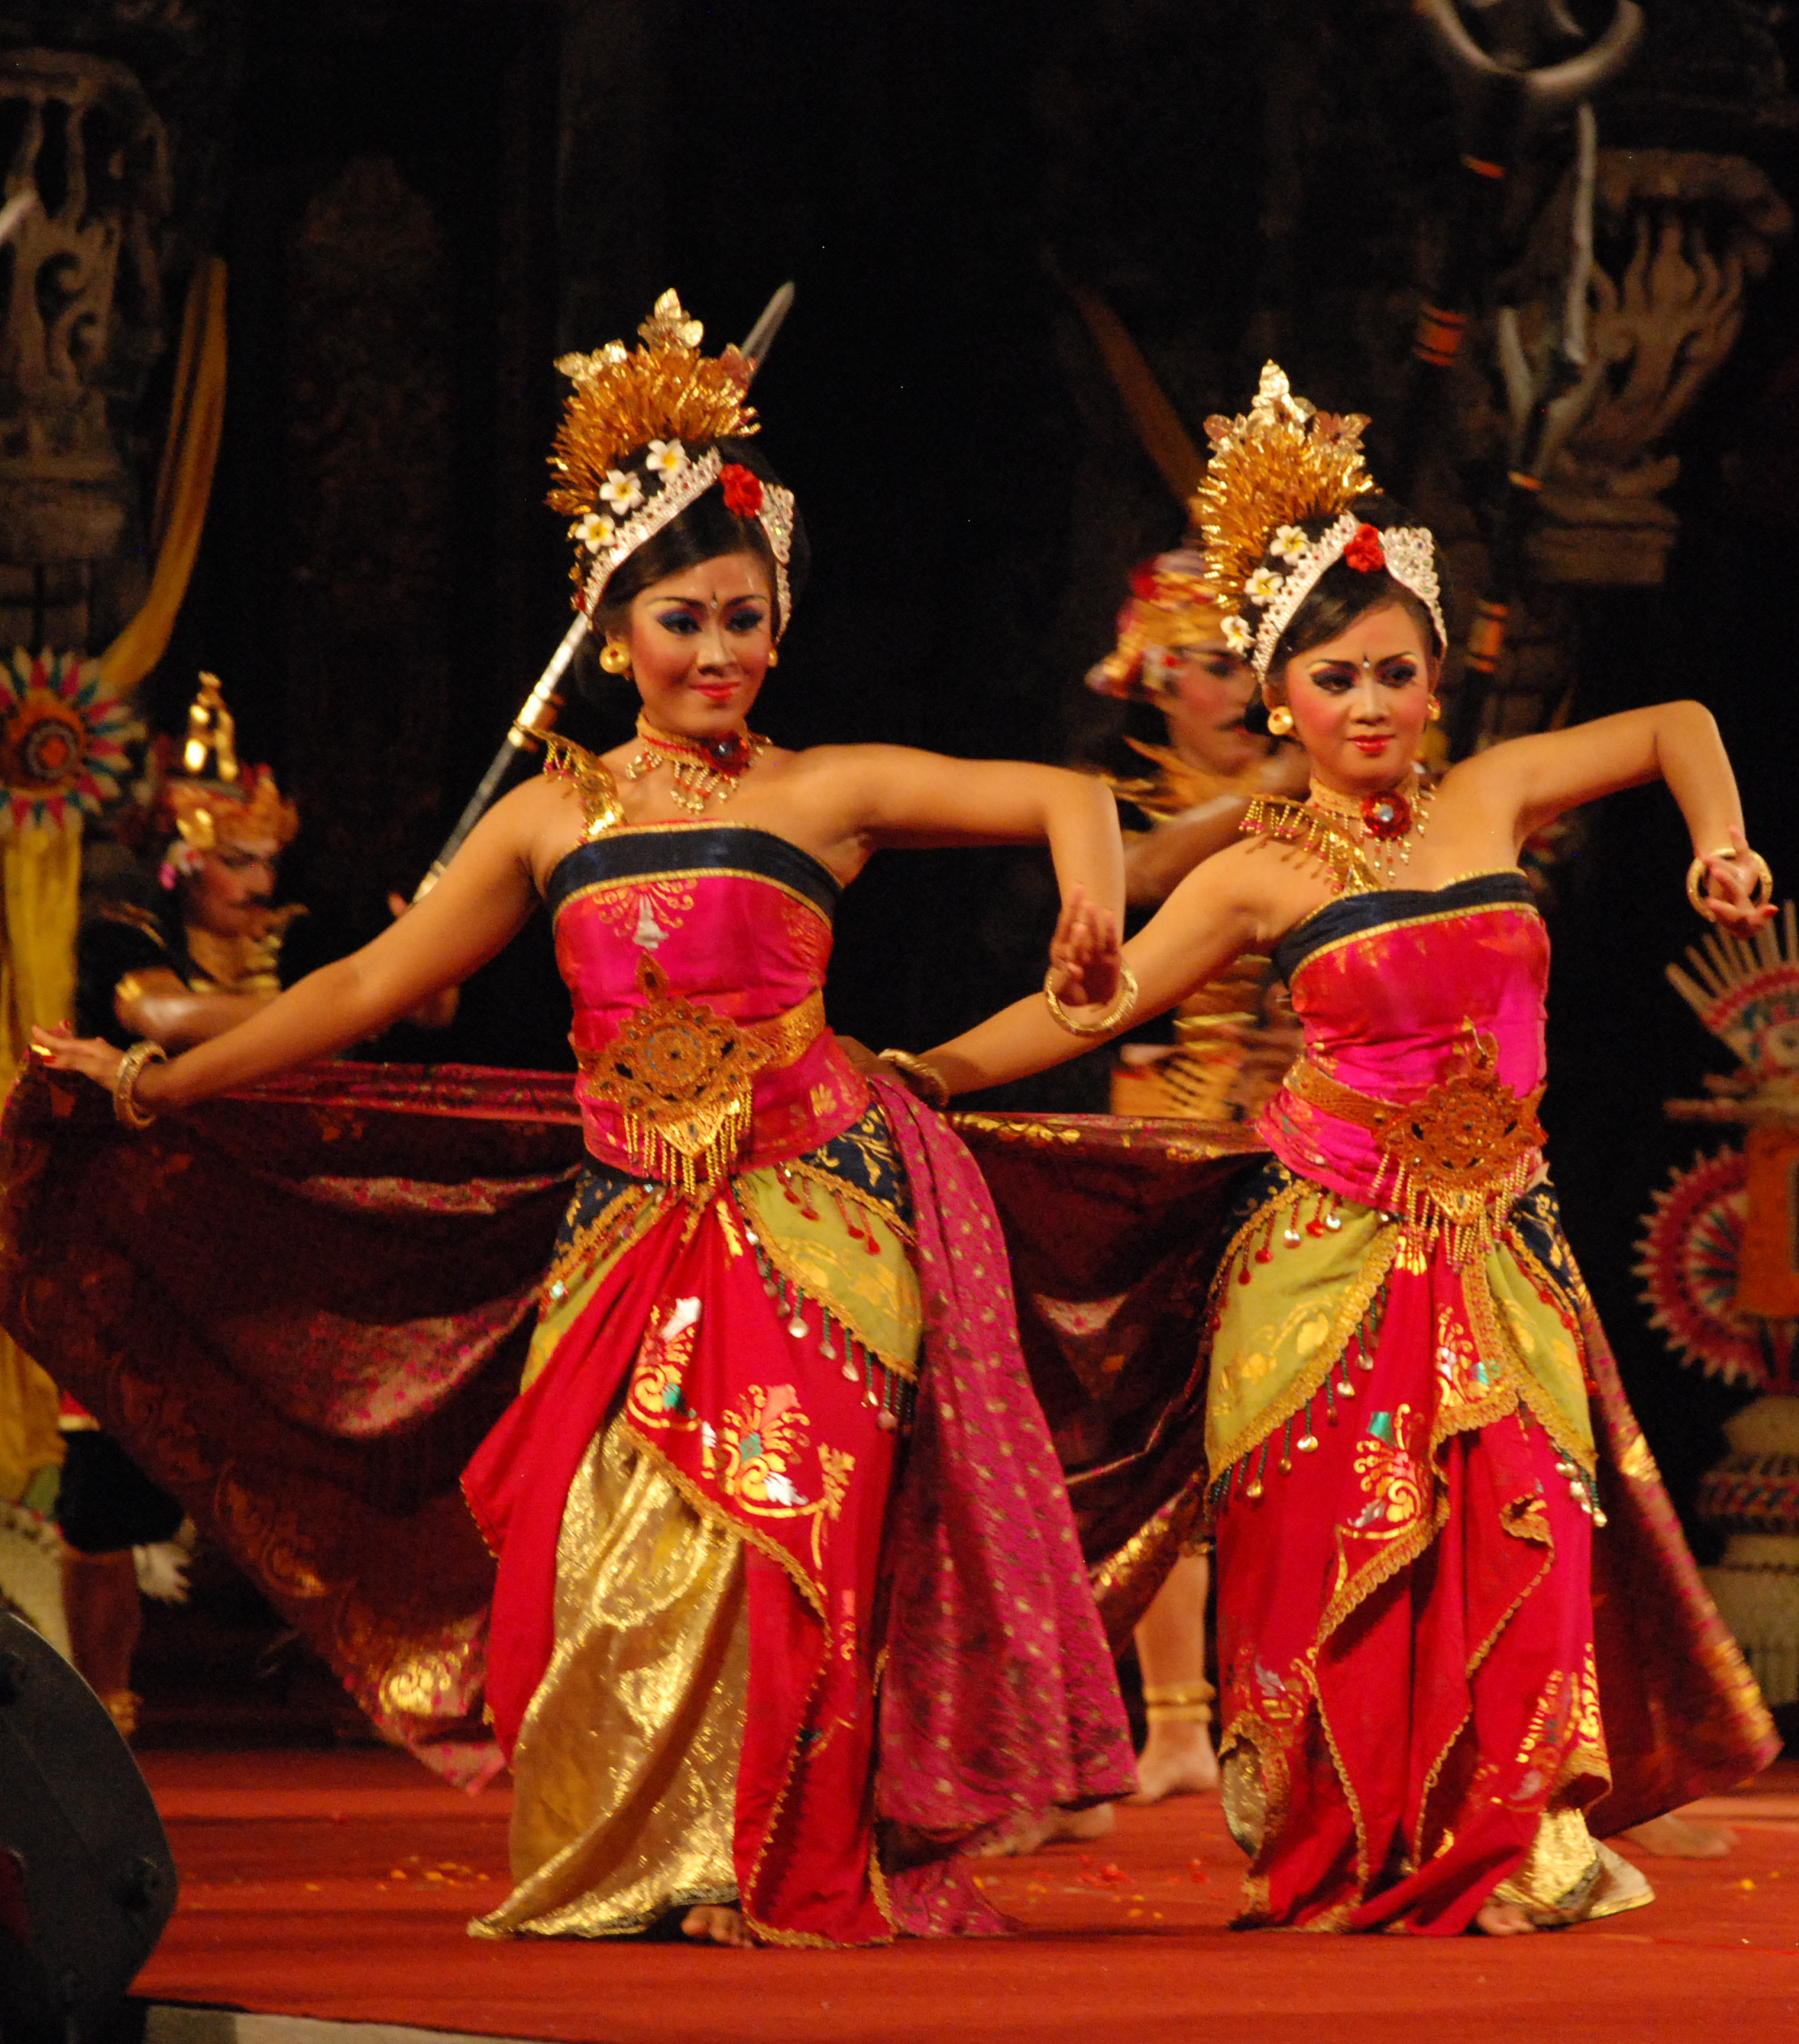
Building Overview
Provide basic training and orientation;
  Team members need to understand what a Support Team is,
  How a team works,
  how to offer support to persons experiencing loss,
  how to set boundaries.

Slide 6
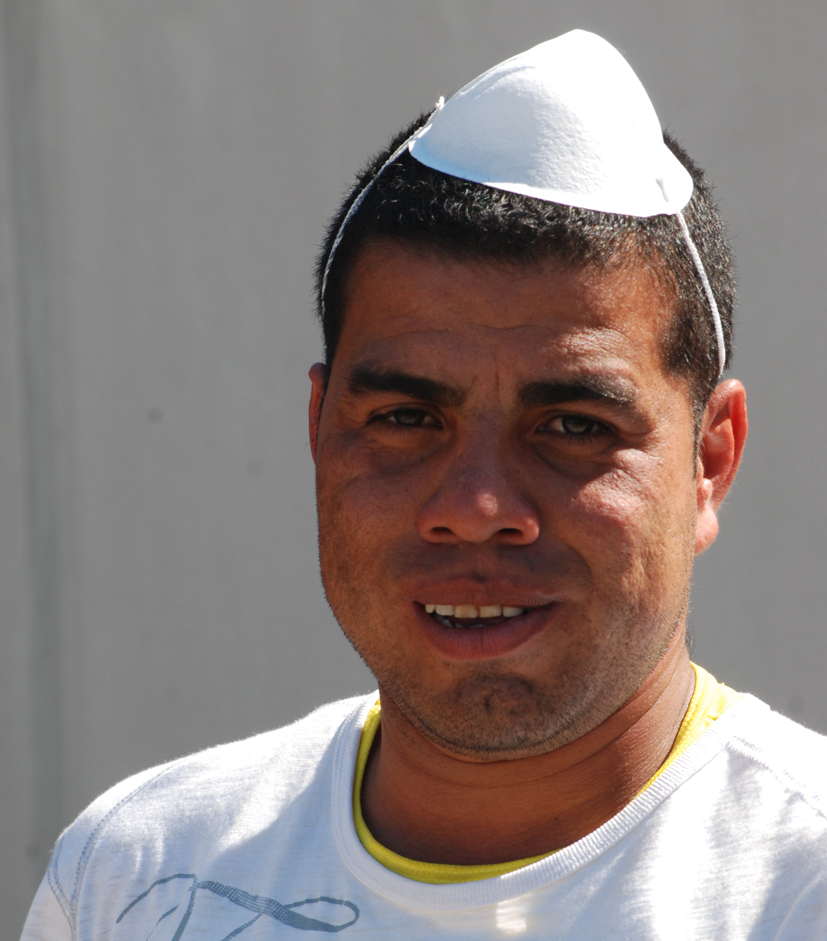
Building Overview
Organize the team for the work of caring.
  Select a Team Leader;
  Determine a meeting location;
  Frequency of meetings;

Slide 7

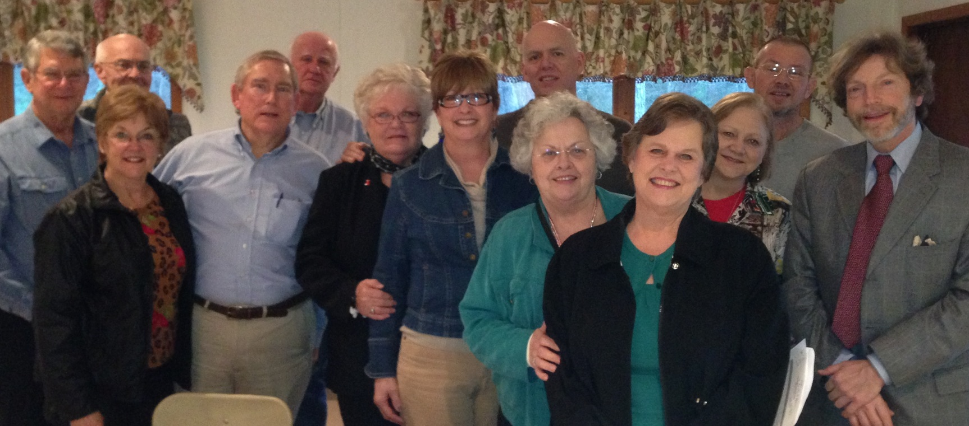
Who are members of the Support Team?
Be clear about who is actually on the team….
A Support Team is more than a number of volunteers doing various tasks. Members of a team understand that they are part of a coordinated TEAM.

Slide 8
Basic Training, or Orientation for New Team Members

Slide 9

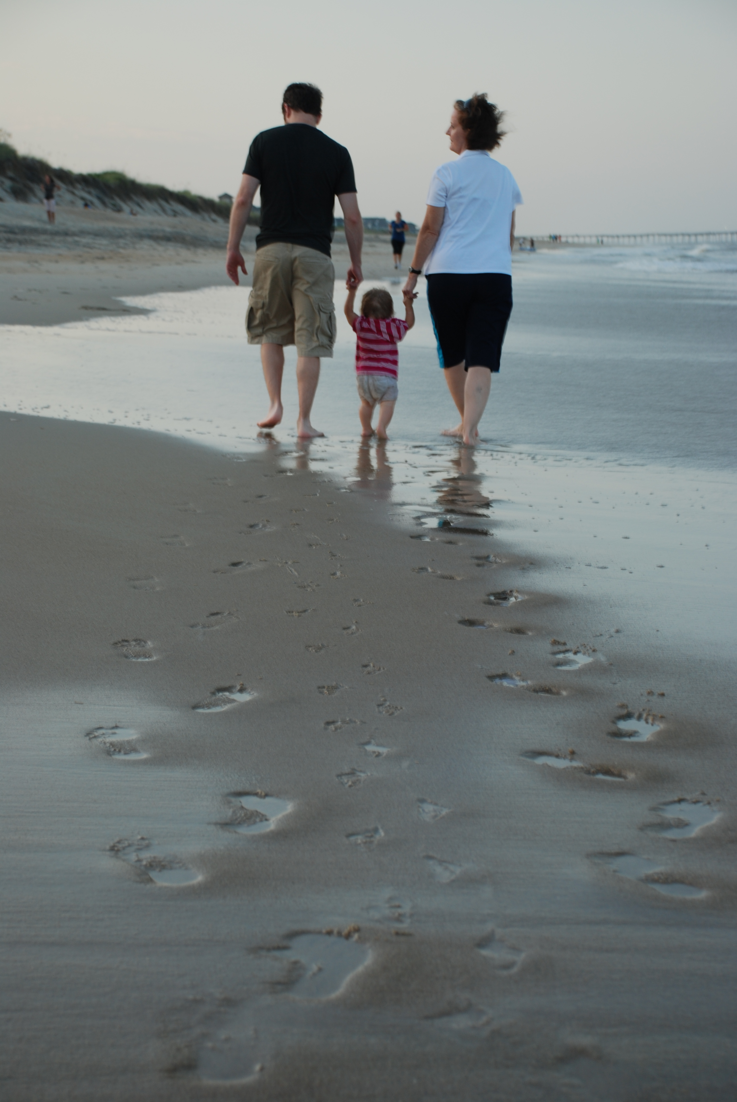
. . . Important Questions
Don’t let enthusiasm to begin make you overlook some . . .
What does it mean to be a member of a Support Team?
How does the team approach the work of caring?
What’s expected of me and what do I expect from the team?

Slide 10
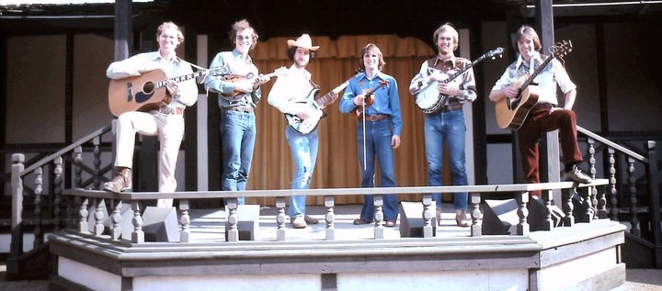
. . . what a Support Team is . . .
Team members need to know . . .
. . . and how a Support Team works.

Slide 11
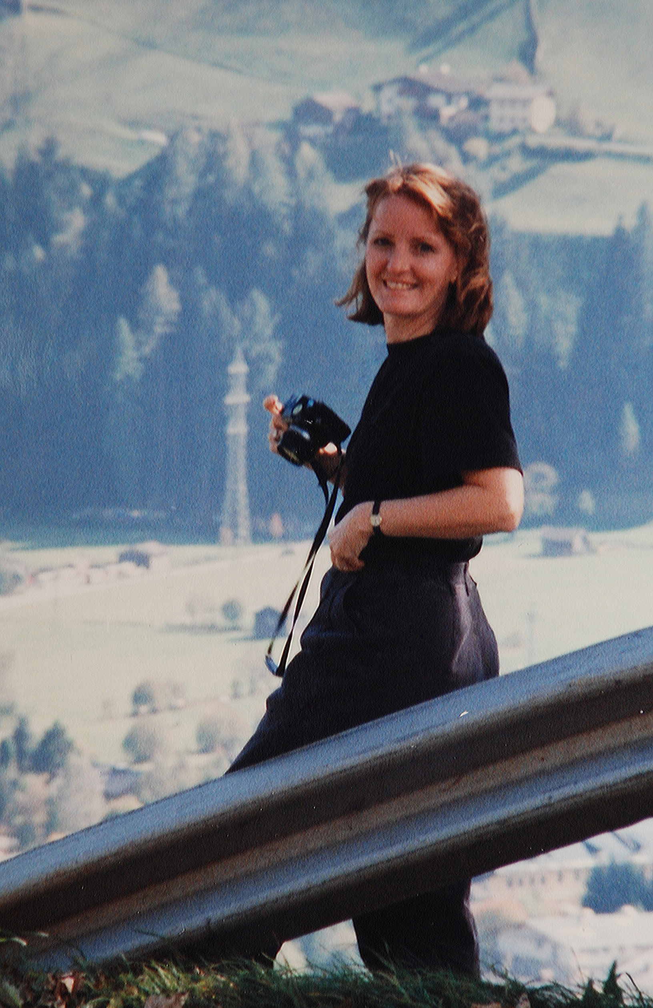
Building a Support Team . . .
. . . means empowering all Team Members to channel their enthusiasm and energy within and through the Team’s caring for the Friend.

Slide 12
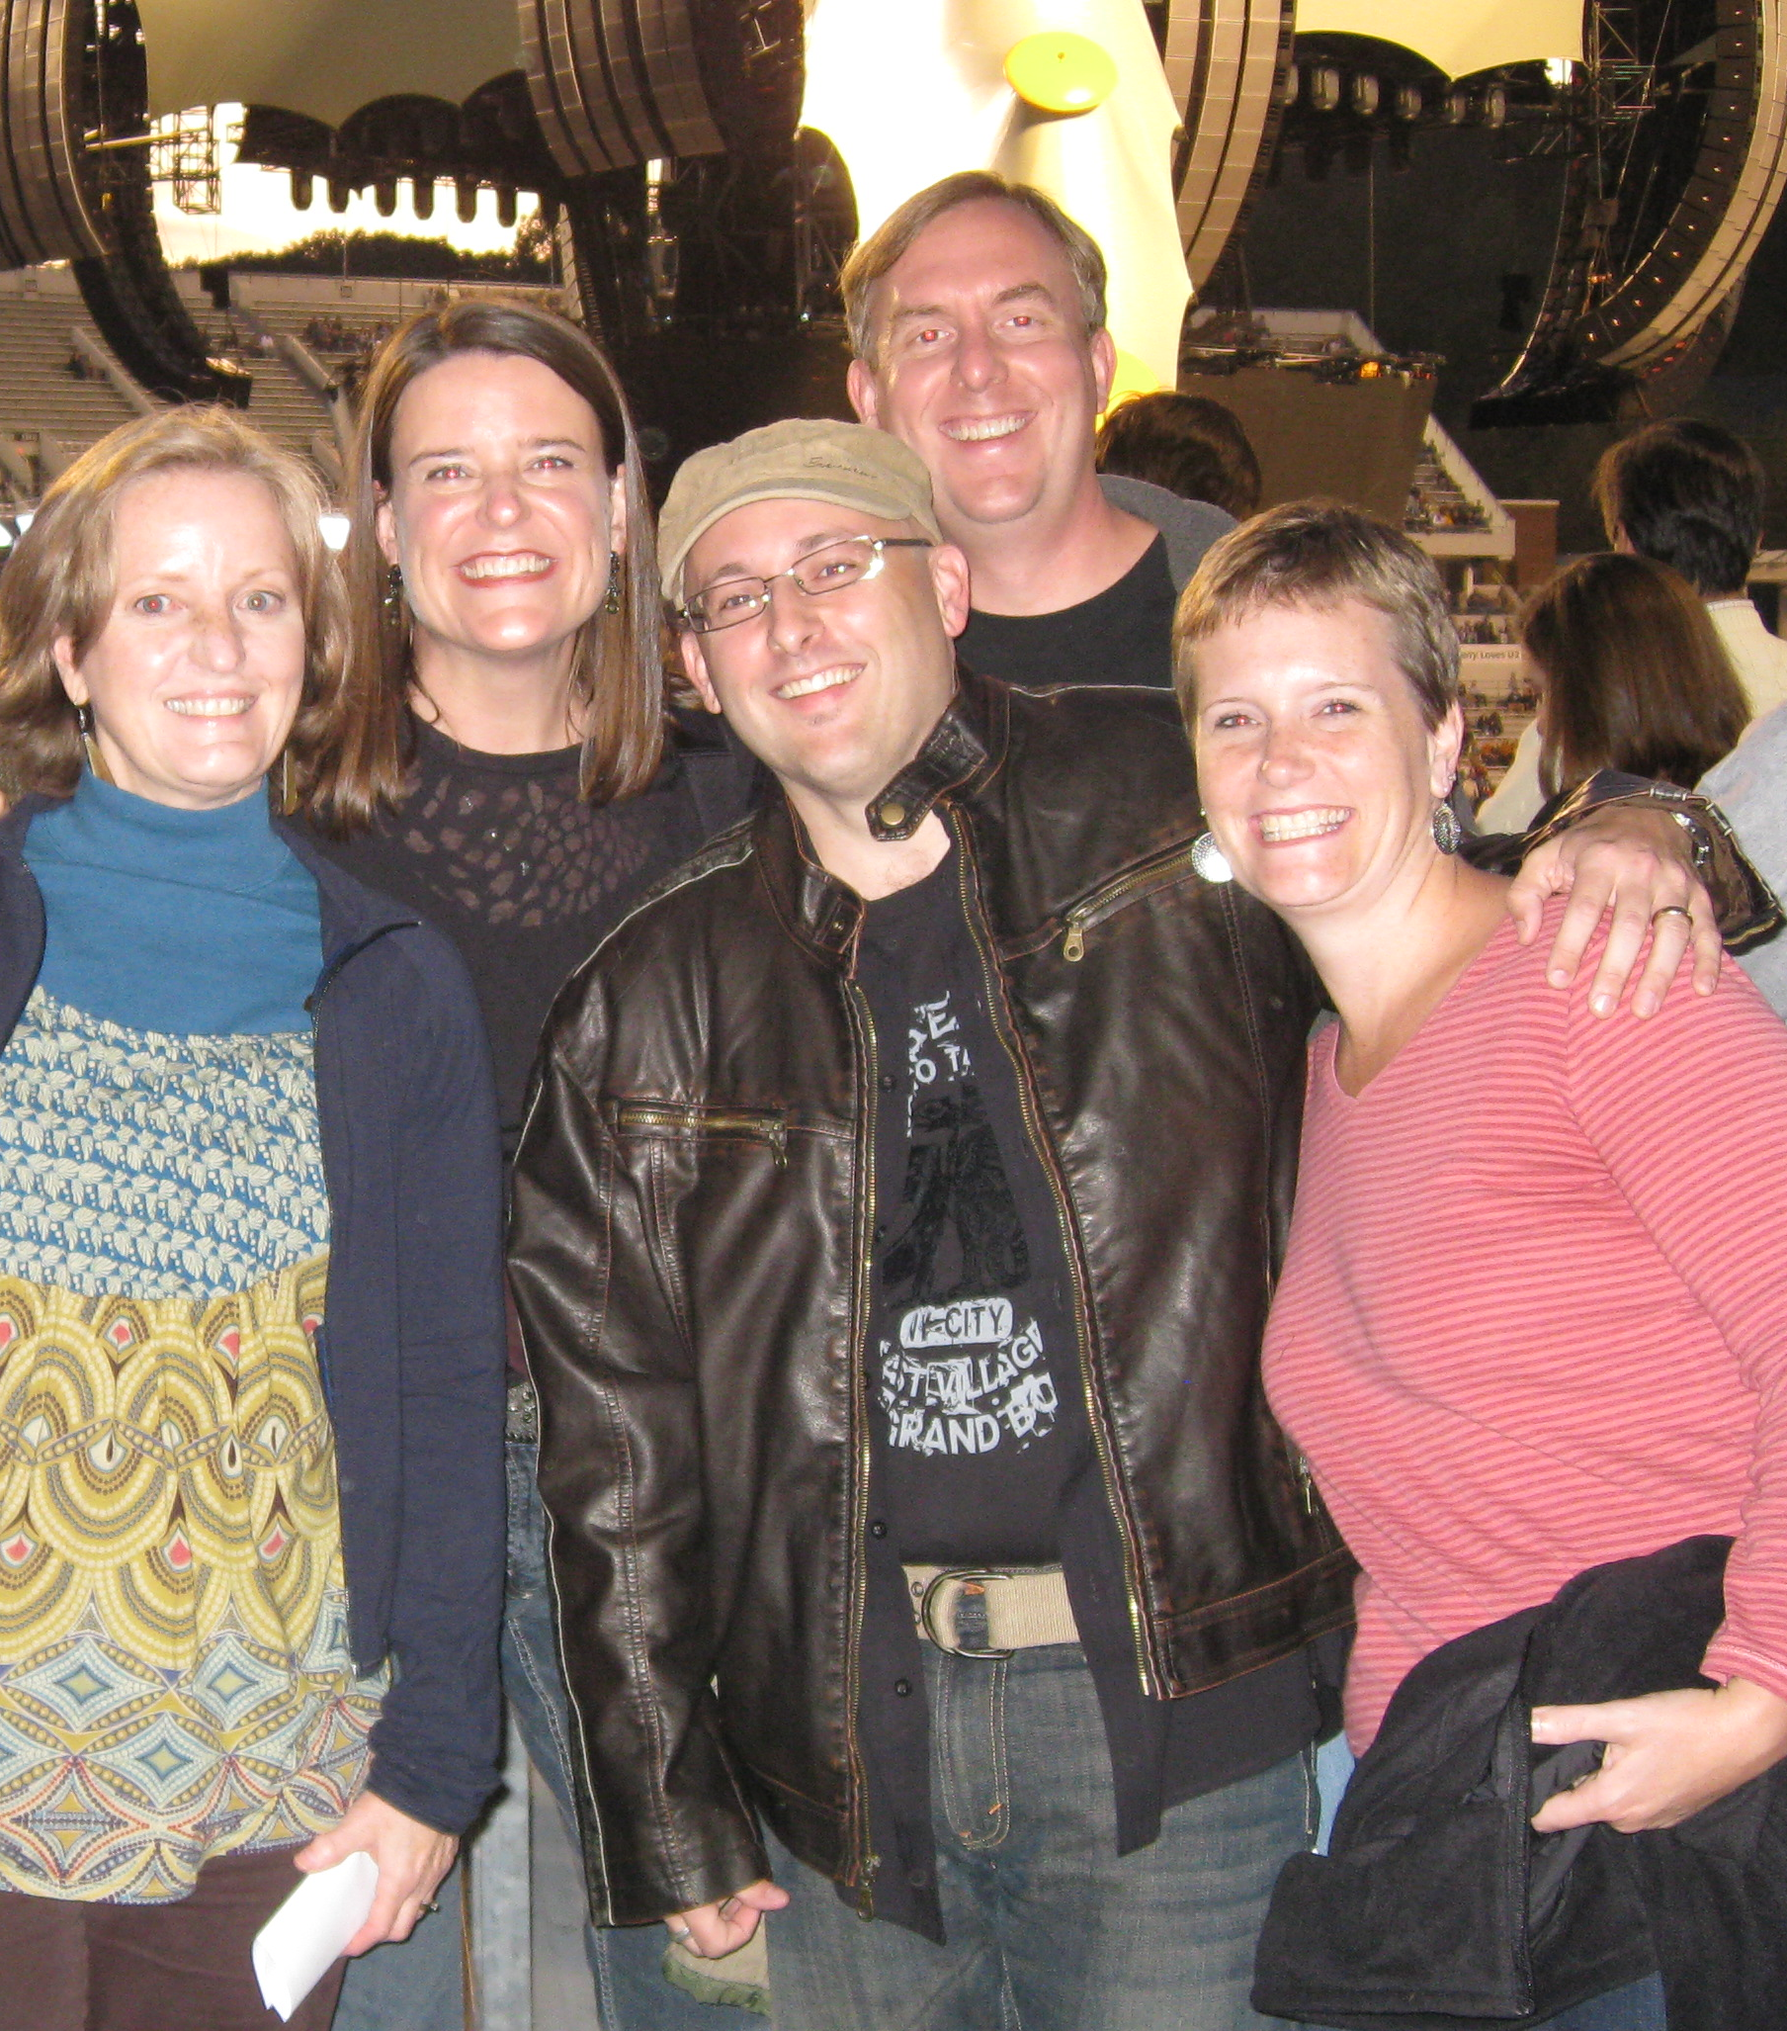
Team Members need to know what’s expected.
Be present at Team meetings.
Communicate openly with Team members and Friend.
Work through problems as they arise.
Learn about the Friend’s health needs.
Maintain confidentiality.
Make decisions as a Team.
Become competent at supporting persons experiencing loss.

Slide 13
Almost all Support Team Friends experience loss, even multiple losses.

Slide 14
Loss . . .
of health;
work;
independence;
activities;
friends . . .

Slide 15
. . . and in some cases, the impending loss of life, itself.

Slide 16
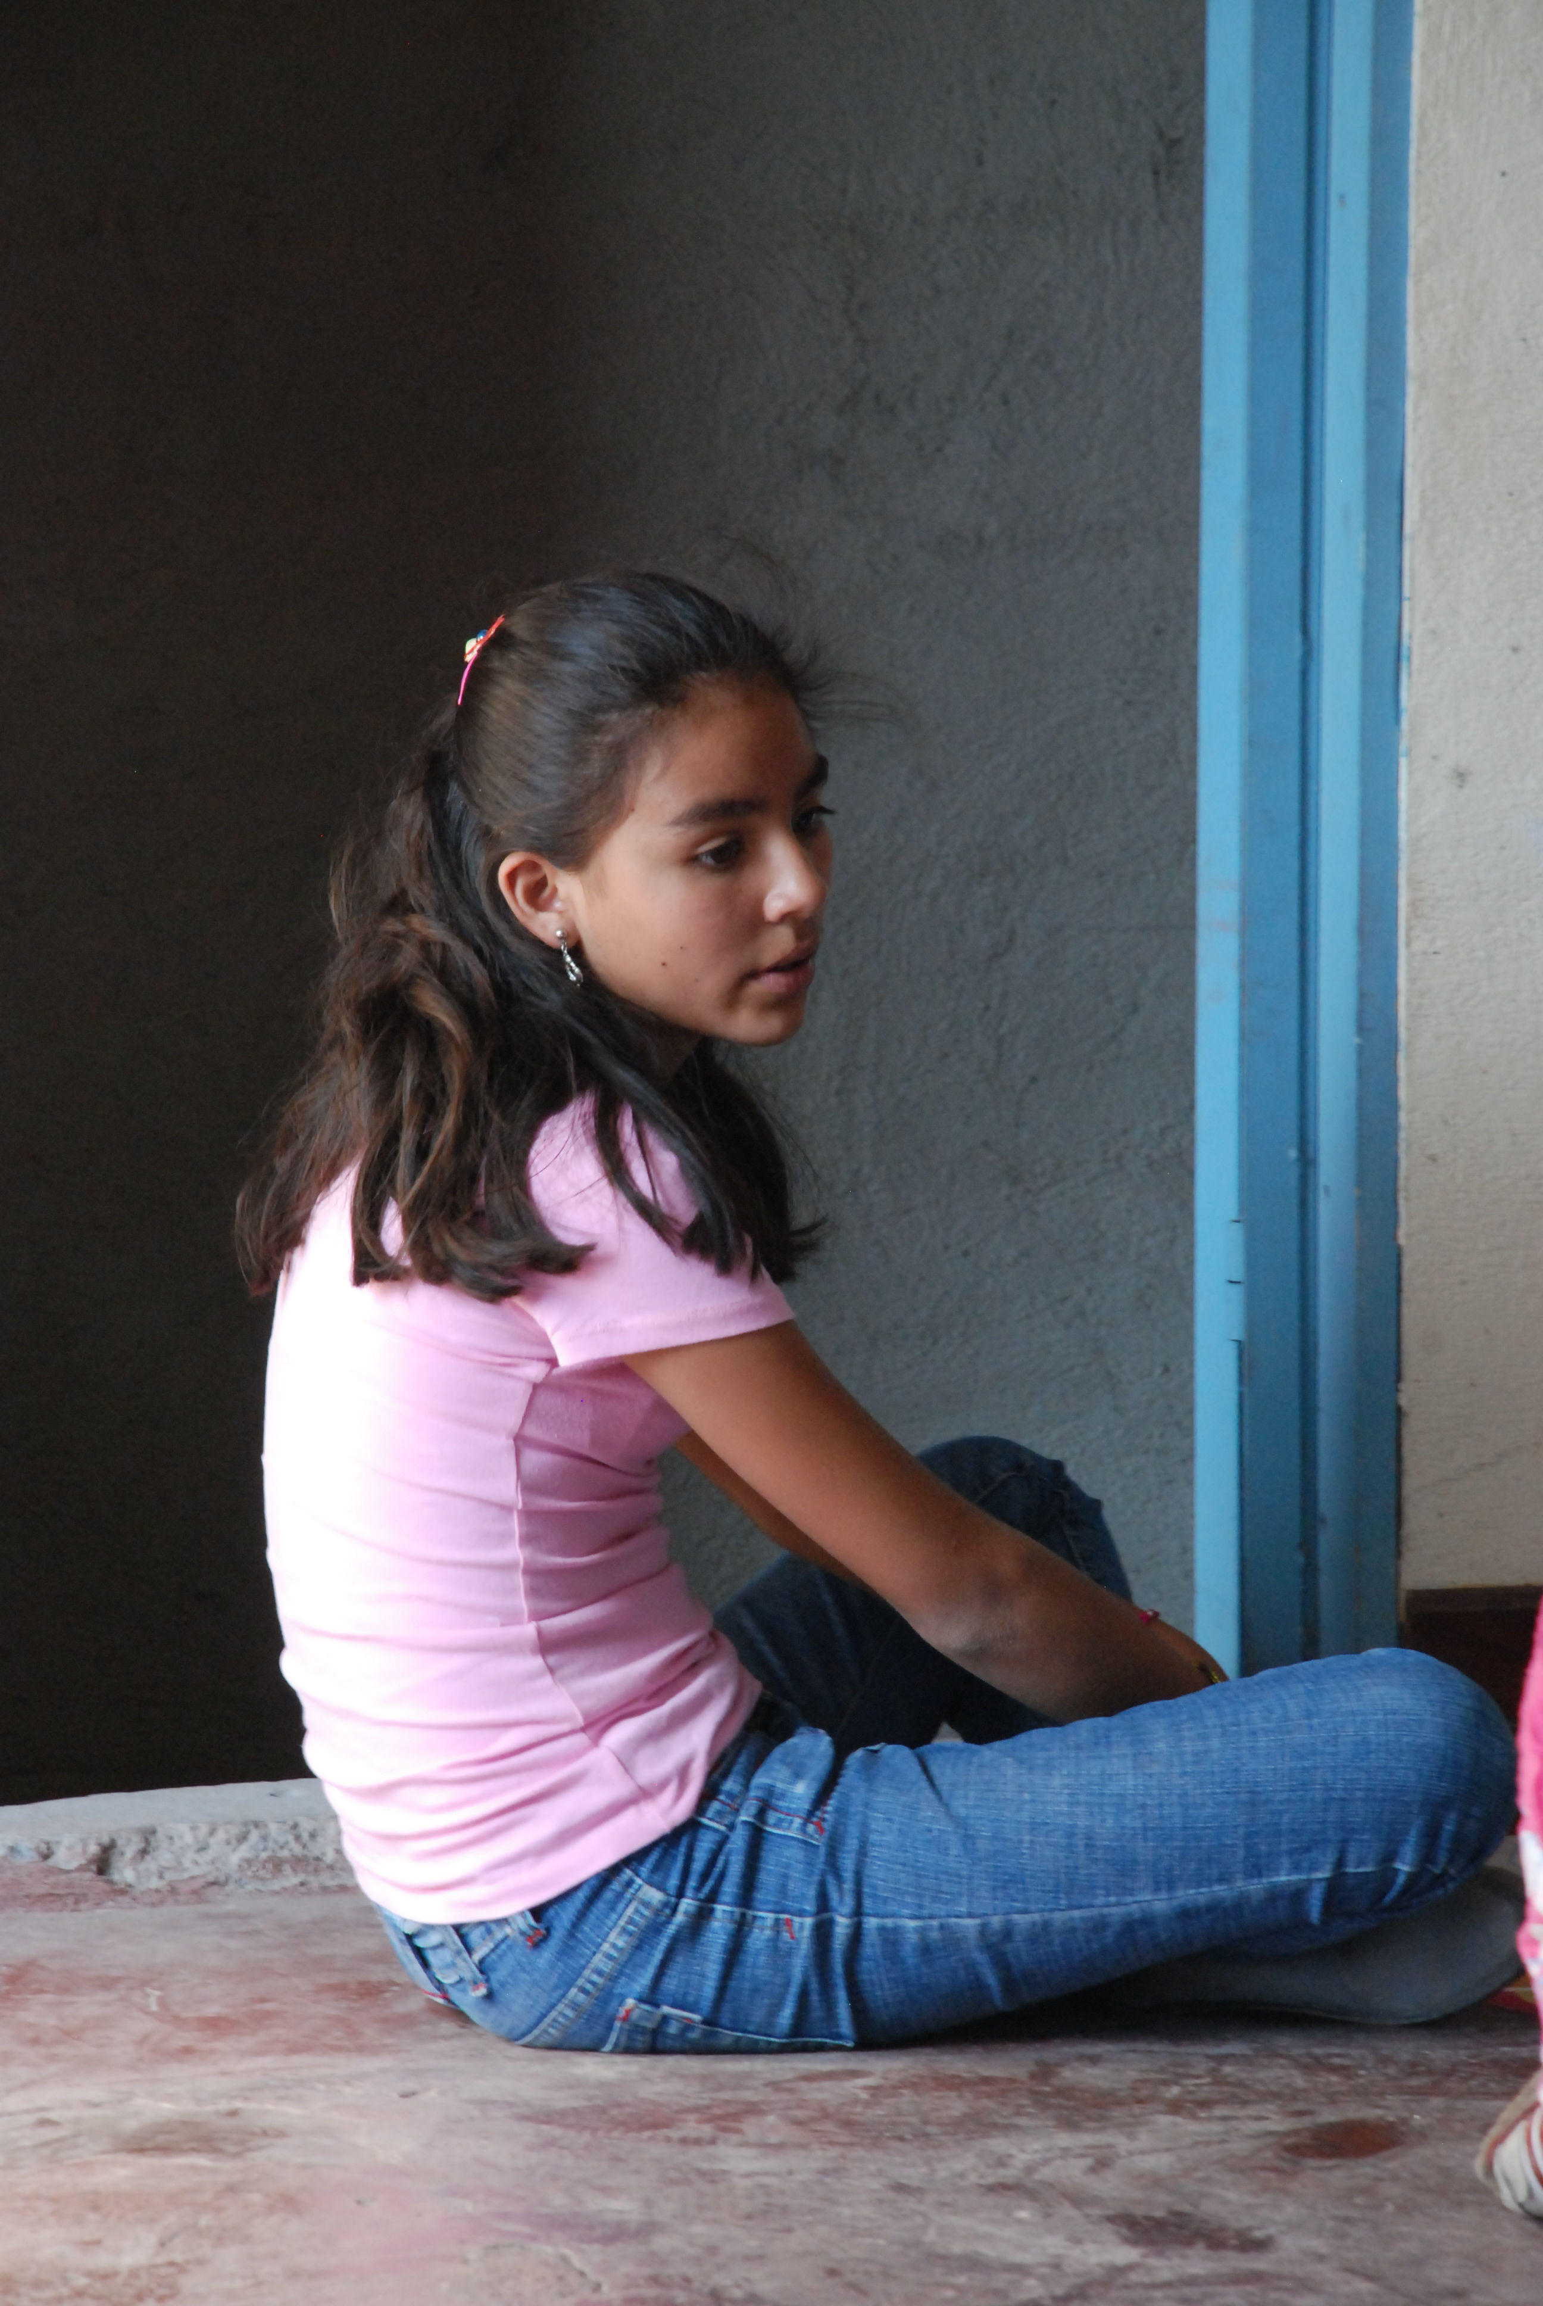
Loss.
It is essential that Team Members are not only sensitive to this reality, but know how to listen and respond appropriately.

Slide 17
. . . about setting boundaries . . .
Team members need to know . . .
. . . how to set them and why it’s necessary.

Slide 18
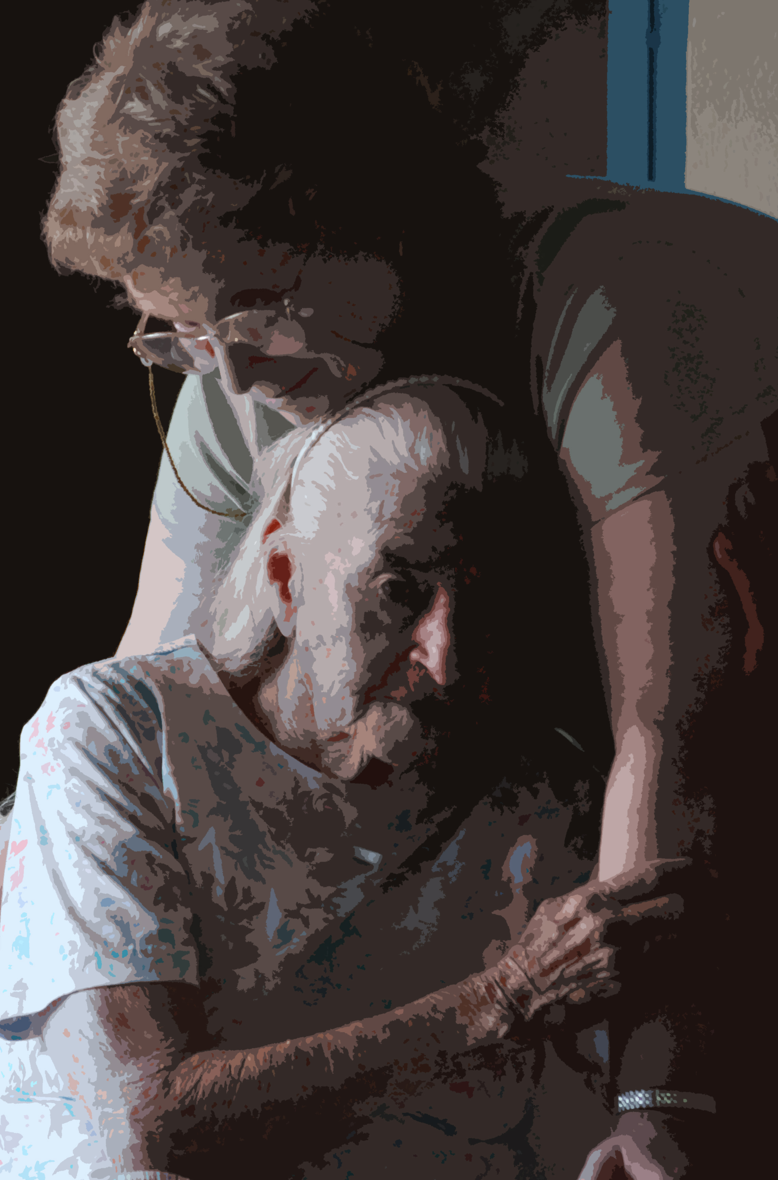
Chronically ill or disabled . . .
The needs of persons who are . . .
. . . can far exceed the ability of volunteers to address. It’s important to have a clear understanding between the care-givers and the Friend regarding what the volunteers can and cannot do.

Slide 19
Chronically ill or disabled . . .
In caring for persons who are . . .
. . . it’s also important for each Team Member to understand what each of the other individual Team Members can and cannot do.

Slide 20
No Team can do everything.

Slide 21
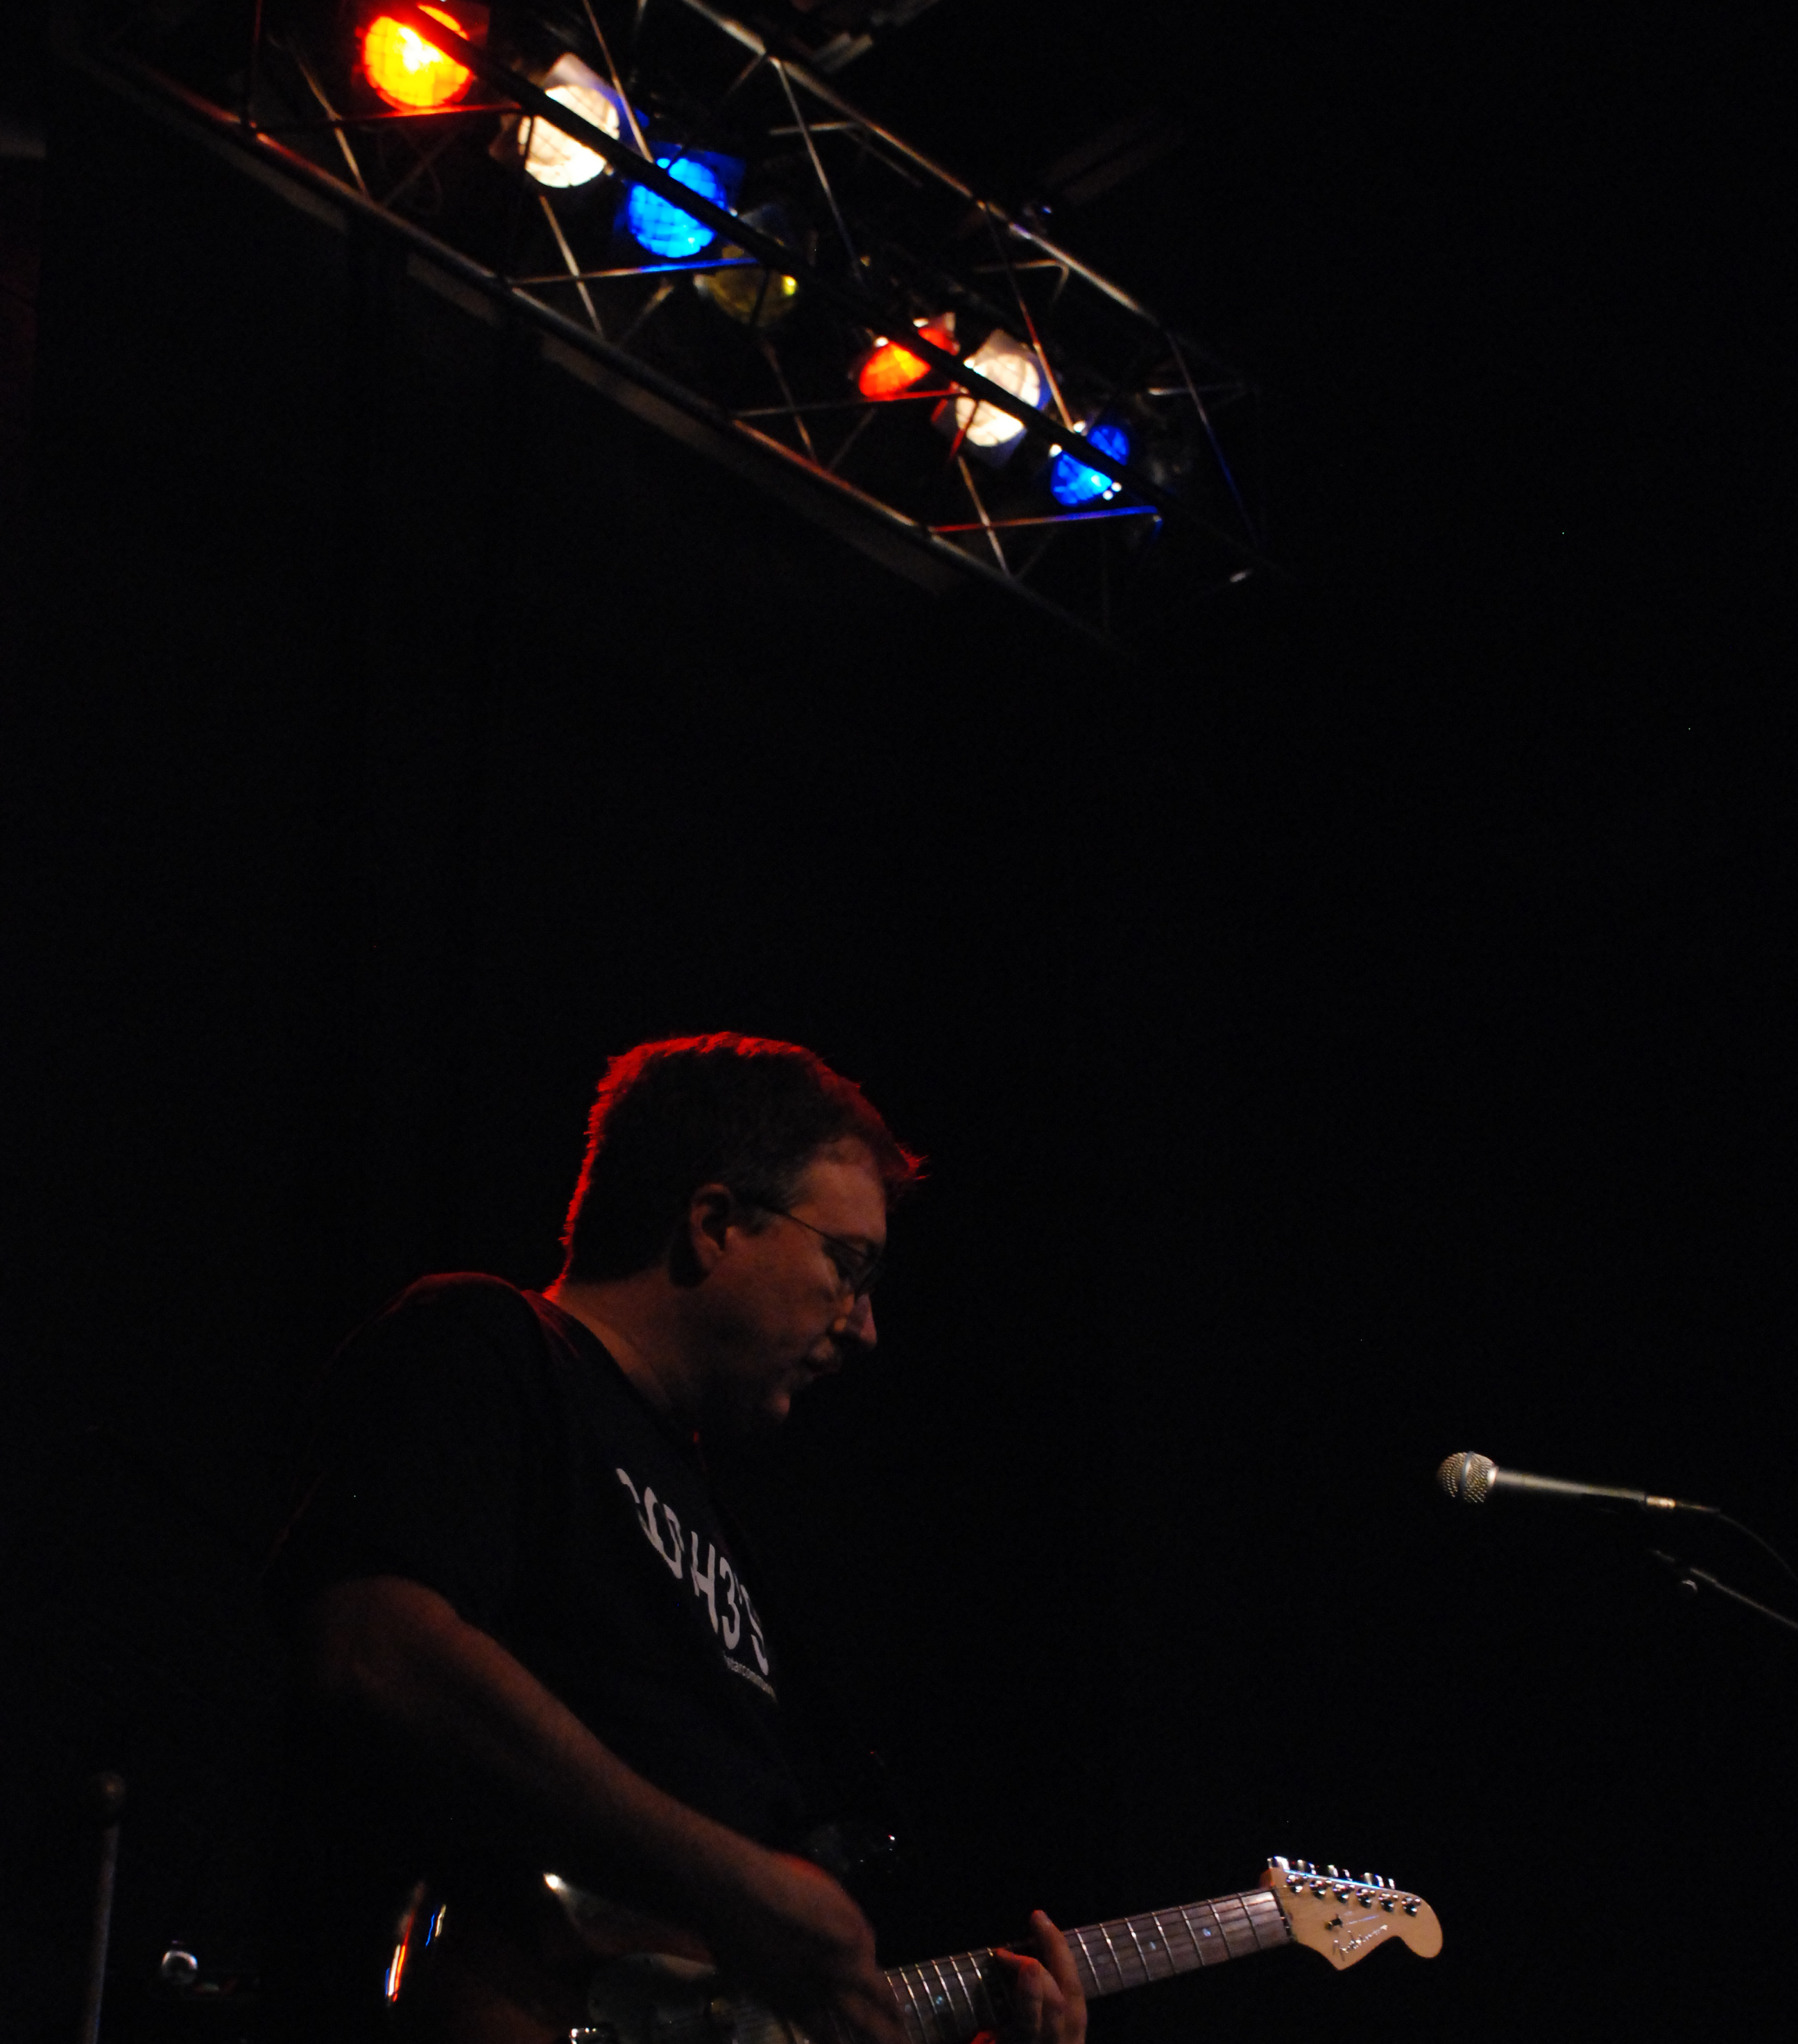
How are Teams trained?
Support Team Orientation which teaches -
  What a Support Team is and how it works;
  How to offer support to persons experiencing loss and grief;
  The necessity and method for setting boundaries and limits.

Slide 22

A separate presentation is available which details a Support Team Orientation.

Slide 23
Organize the Team for the work of caring.

Slide 24
The Support Team Leader
Conducts the day-to-day activities of the Support Team;
Keeps schedules;
Conducts team meetings;
  Begin and end on time -
  59 minute rule -
  Communicate, Educate, Coordinate -
Communicates with team members;
Participates in caring.
(Herbert von Karajan)
1908-1989

