Slide 2
Caring
Caring Overview - plan to care and work the plan . . .

Slide 3

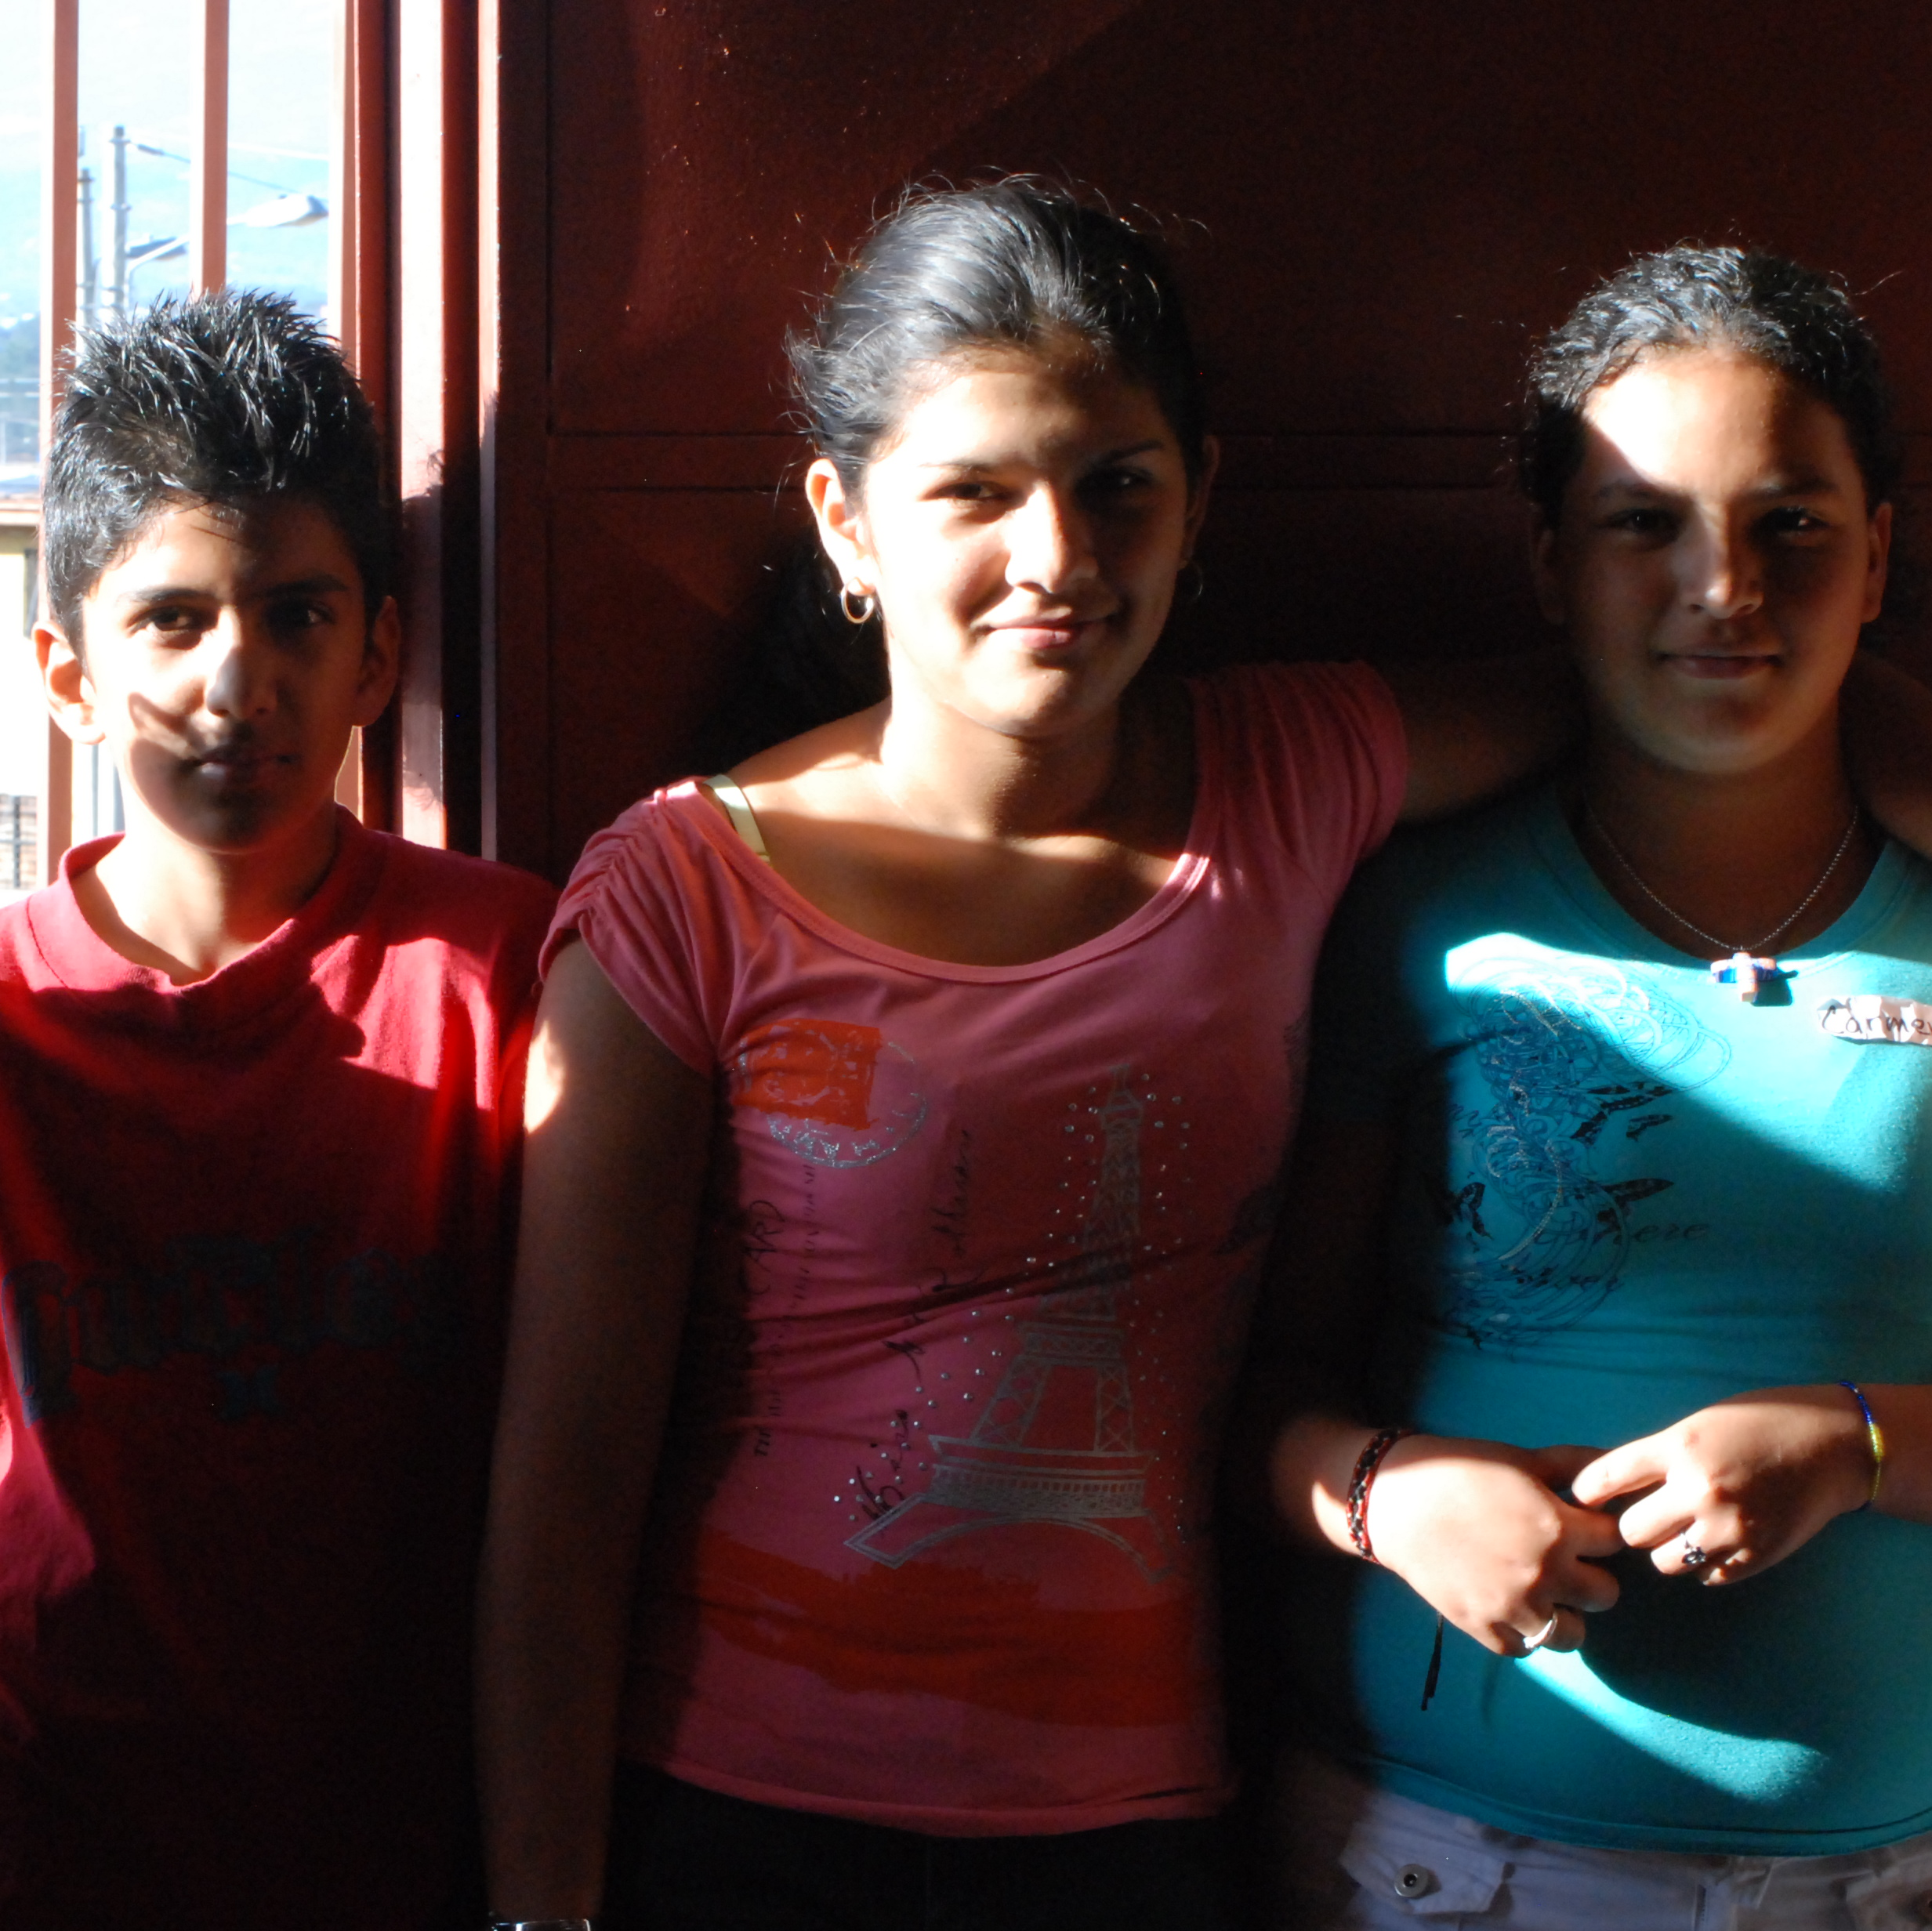
The Support team . . .
Cares for the Friend,
for each member of the Team,
and for the Team as a whole.

Slide 4
No medical advice
Do not administer medications or do nursing/medical care
Do not give or loan money

Slide 5
Establish a good foundation by communicating clearly during the beginning, building, and connecting phases of developing the Support Team.
Regular Team meetings bring everyone on board regarding planning, the Friend’s ongoing needs, and becoming more invested in the actual work of caring.
The Team Leader conducts efficient meetings and coordinates the plan.

Slide 6

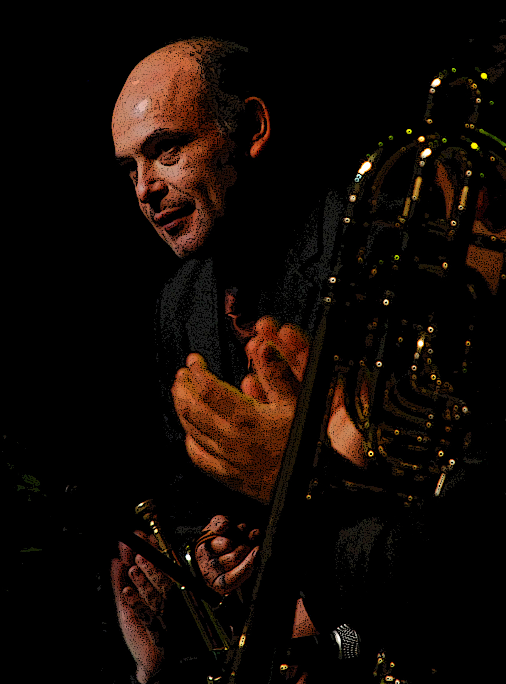
the team honors the time and effort of all team members
Everyone is involved in planning and supporting the implementation of the plan.

Slide 7

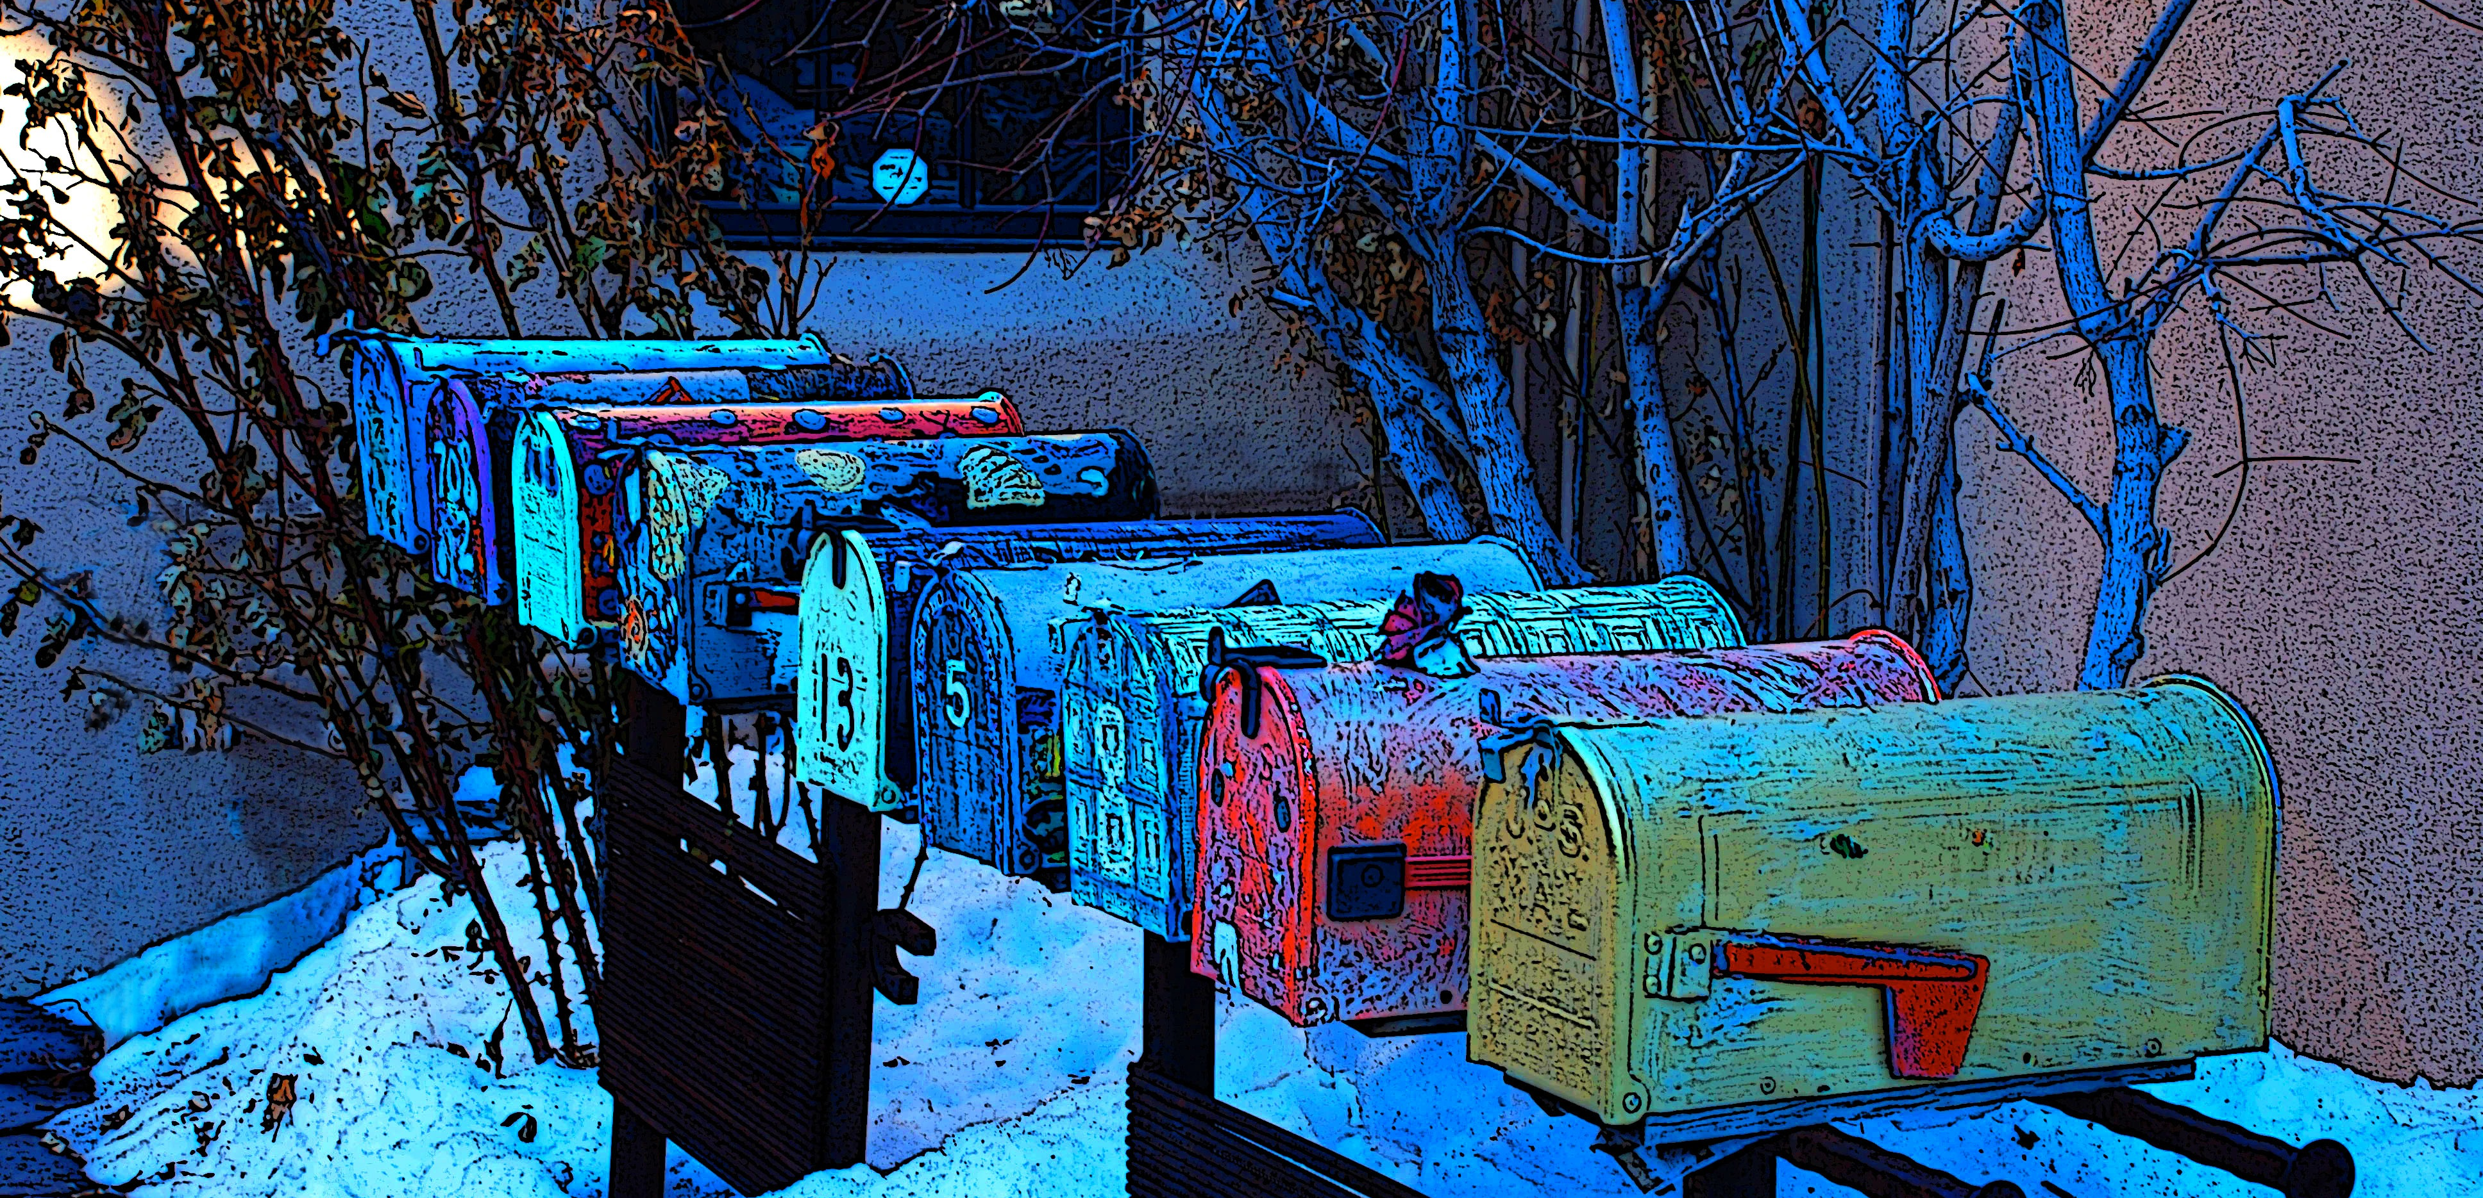
Communication - Essential!!
Good communication is essential throughout the life of the team - from beginning to sustaining.

Slide 8
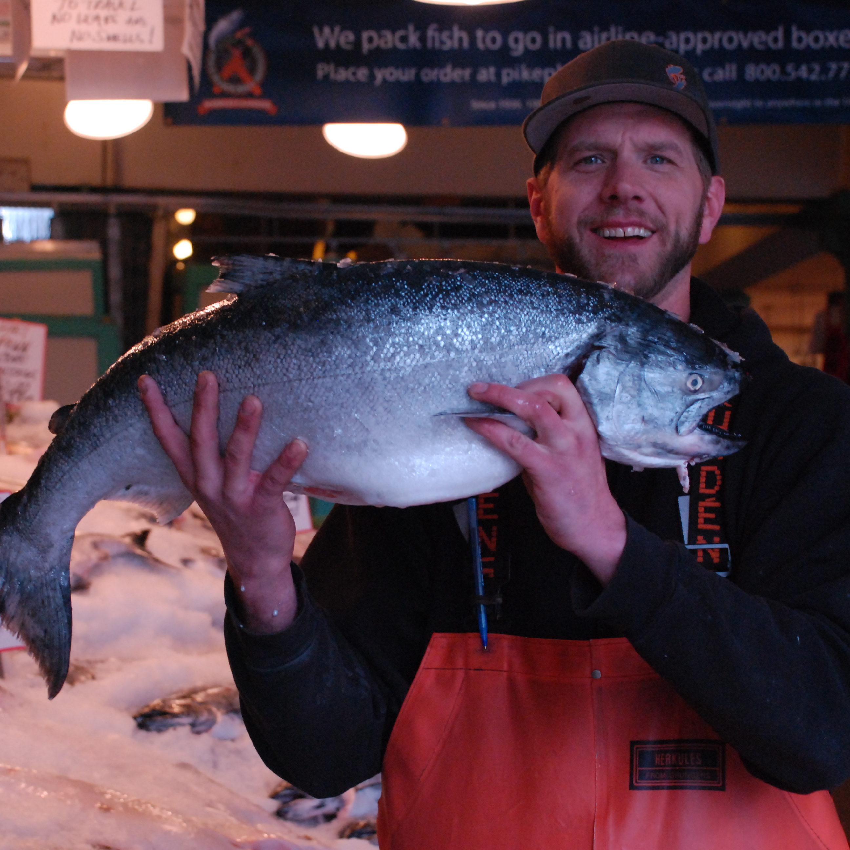
Good communication . . .
helps all team members be part of the process
educates the members to be more effective
helps members help each other better
schedules everyone’s help based on the specific needs of the Friend

Slide 9
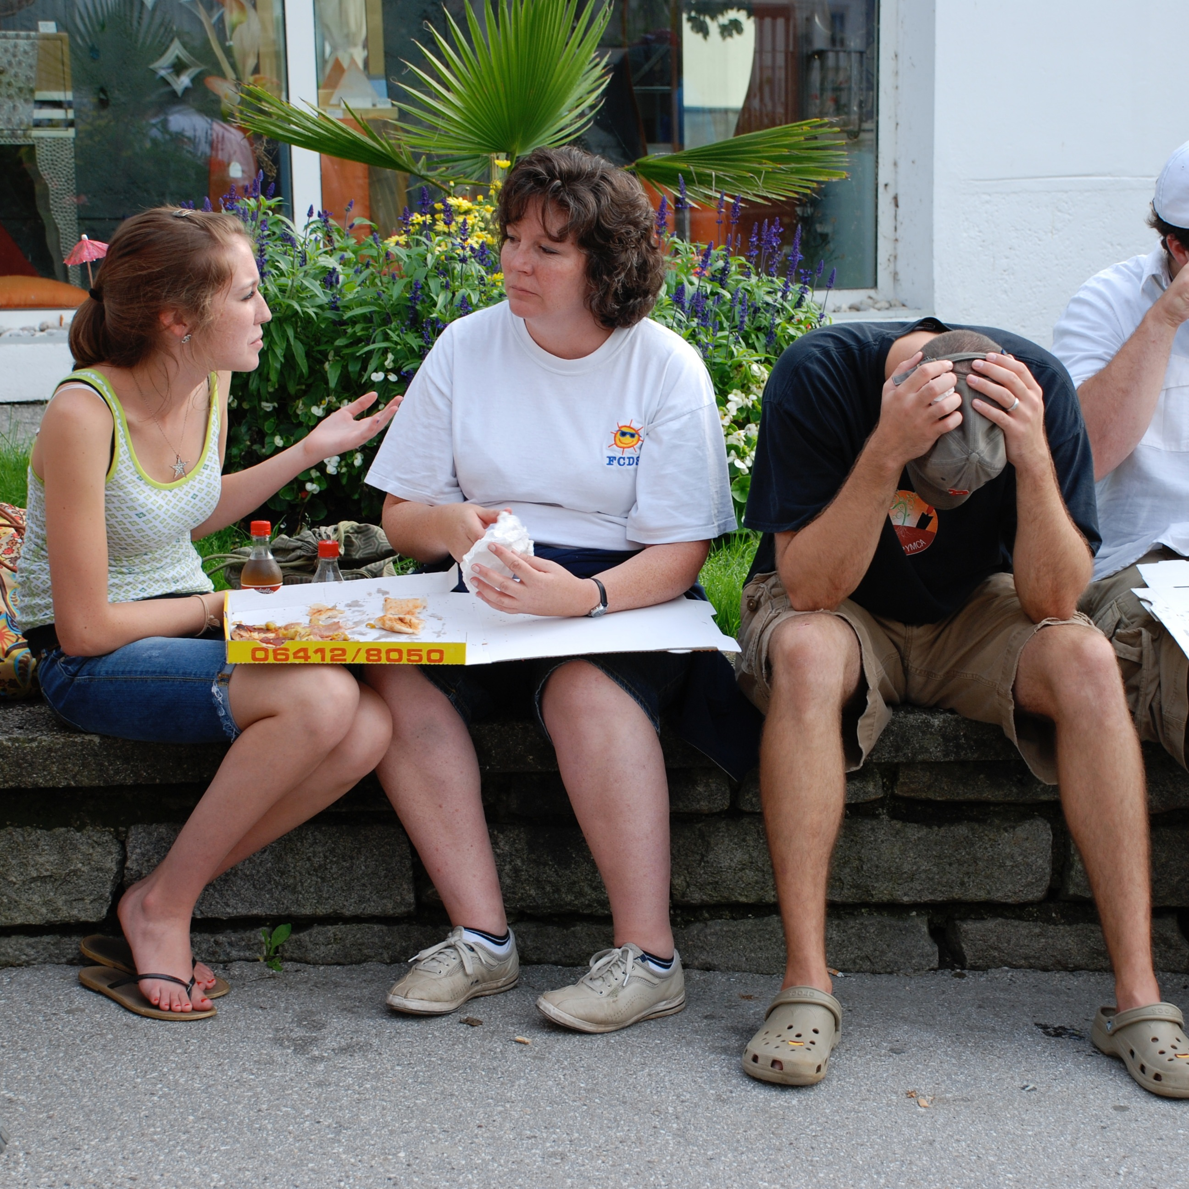
Regular team meetings
Meetings designed so that they accomplish something!
Meetings designed to honor the time team members have to give.
Meetings that begin on time, end on time and last . . .
. . . 59 minutes! (or less)

Slide 10
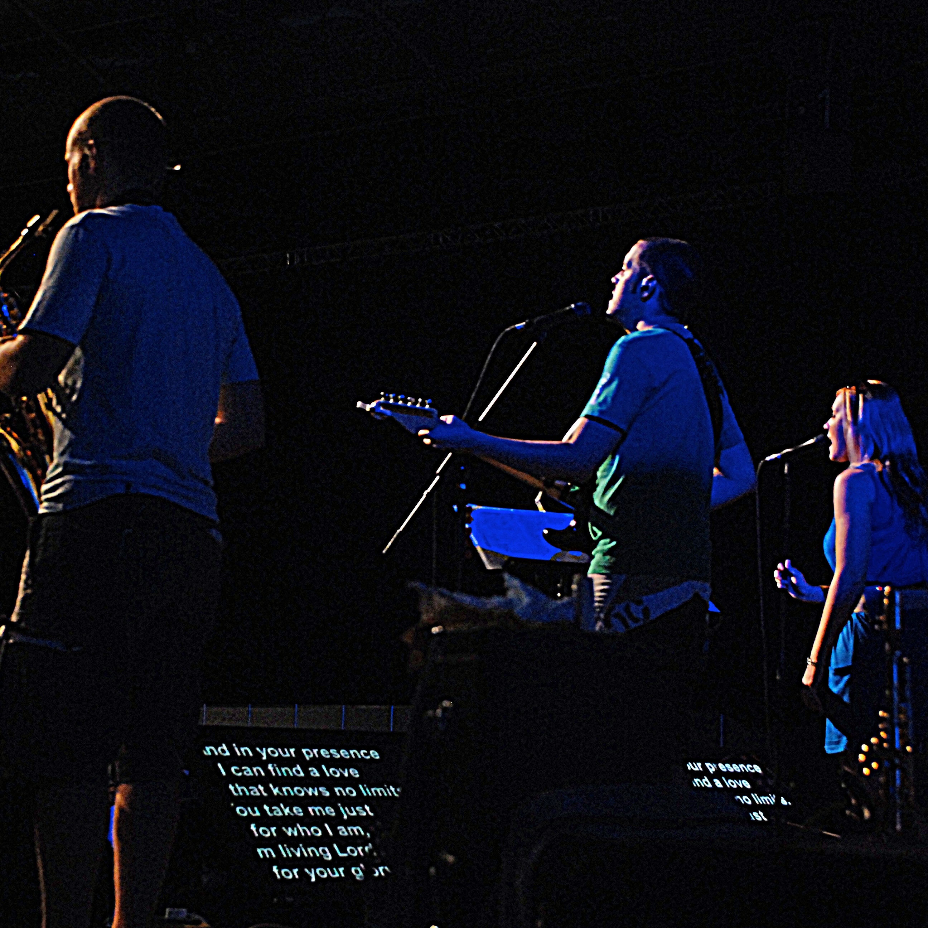
Meeting agenda . . .
Communicate
Educate
Coordinate

Slide 11
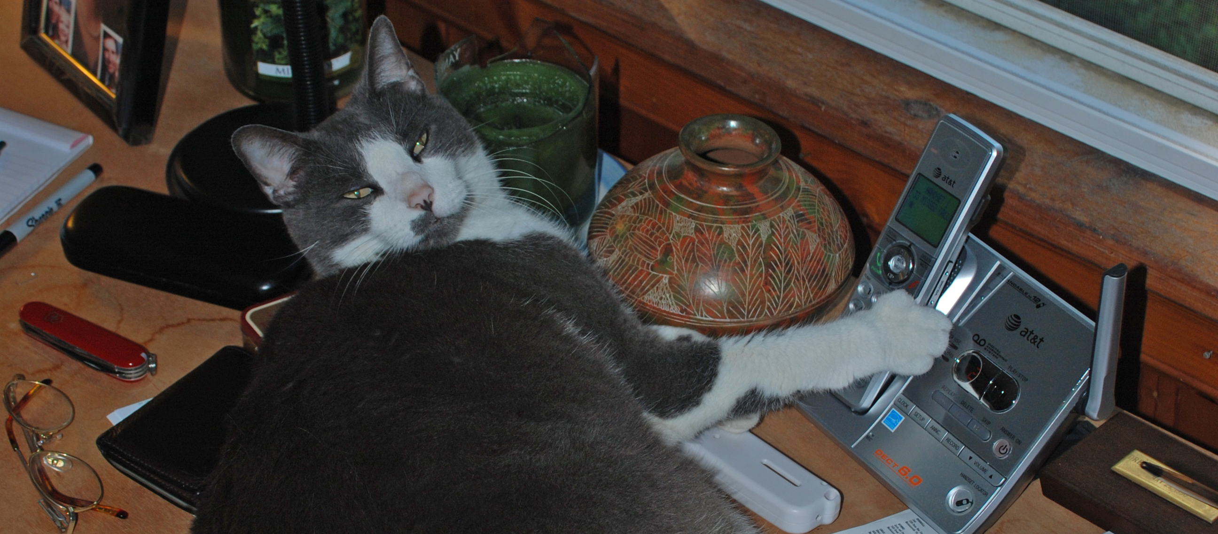
The Team Leader Facilitates. . .
The 59 minute rule!!!!!
The Team Leader plans and leads efficient meetings (59 min-rule).

Slide 12


The Team Leader hangs in there!
Confirms times with the Friend
Coordinates changes
Listens for any further changes that may need to be addressed

