Slide 2
Connecting
How to connect a Support Team to the person who will be the focus of caring.

Slide 3


Connecting . . .
. . . requires clarity about the needs of the Friend and what the Team is able and willing to do.

Slide 4

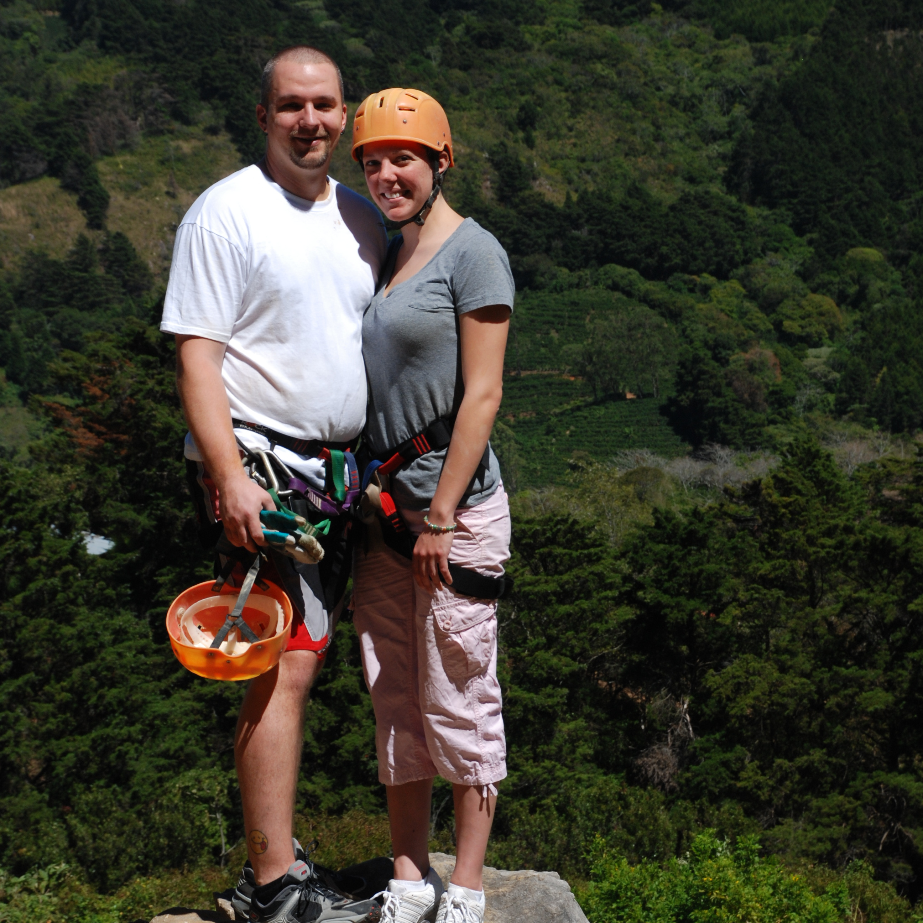
A Team and a Friend Connect by doing Three things.
1) A connecting visit confirms the caring relationship between the Friend and the Team.
2) The Support Team meets to determine their specific tasks and to schedule their visits.
3) The Team Leader makes a follow-up visit to let the Friend know what to expect.

Slide 5


Confirming the team-friend relationship
The Connecting Visit

Slide 6
The Connecting Visit
Involves the one who made the initial assessment;
The Support Team Leader;
The Friend’s primary care giver;
The Friend.

Slide 7
The Connecting Visit
Review the needs of the Friend.
The Team Leader shares about the team members and about their joy.
The Team Leader shares about the upcoming Support Team Meeting when the needs will be considered and which ones can be addressed.
The Team Leader tells the Friend when he or she will hear back from the Team.

Slide 8
You can find a detailed description of a Connecting Visit at the Support Team Network website,
www.supportteams.org.

Slide 9
Some teams have secured a written and signed agreement from the Friend which outlines in writing what the team and the Friend have agreed upon.
A sample agreement is available at the Support Team Network website by clicking on www.supportteams.org.
Also. . .

Slide 10
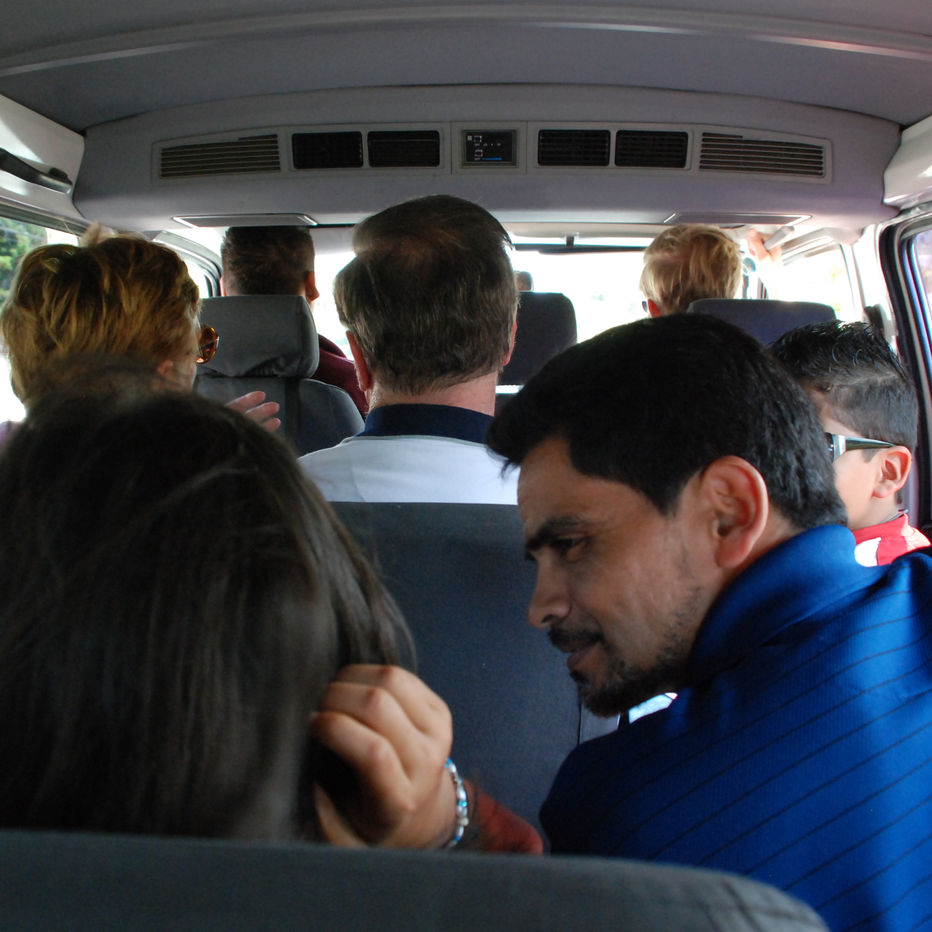
The Team Decides on its response
The Team Members get to know one another (if this is a first meeting of the team).
Review the Friend’s need request, including the specific times that may be required.
The various team members decided what they want to do.

Slide 11
Resources for the Support Team meeting
You can find more on the “Team Meeting Following the Connecting Visit” at the STN website by clicking www.supportteams.org
“Support Team Member Information” is available at
An example of a “Time and Task Calendar” at

Slide 12

Follow-up with the friend
After the Support Team Meeting, the Team Leader completes the connecting phase by informing the Friend what the Support Team will be able to do.

Slide 13
A Support Team probably won’t be able to do everything a Friend desires.
Honest, clear communication lets the Friend know exactly what to expect and when from the Support Team.
As needs change over time, the Support Team practices the same process of assessing and determining whether the team can meet new needs as they arise.

