Slide 2
Sustaining

Slide 3

Characteristics of Sustainable Development
create and enhance spaces which work well and look good
value and protect diversity, local distinctiveness and cultural identity
ensure access to good food, water, housing and fuel at a reasonable cost
maximize everyone's access to the skills and knowledge needed to play a full part in society
empower all sections of the community to participate in decision-making

Slide 4
Two Things Sustain a Team
The Team Members remain true to the Covenant they’ve signed
The Team Leader makes sure the following characteristics take place . . .

Slide 5

The 59-Minute Rule

Slide 6
Effective Communication
All team members are a part of the process
Sharing data/information relevant to the Friend’s needs
Team members get to know one another
Reviewing schedules

Slide 7
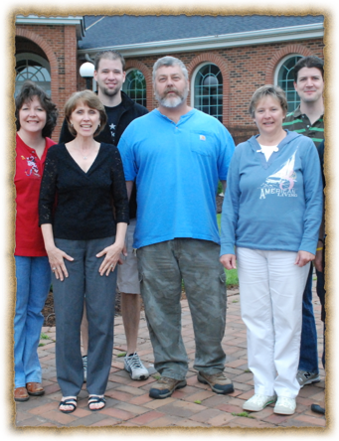
Every Team Member Involved
Encourage attendance at monthly meetings
reinforce the rule about doing what you love
Seek feedback and monitor their experience

Slide 8
Immediately address
difficulties that arise.
Don’t assume issues will resolve themselves
Remember the no-guilt rule in addressing difficulties

Slide 9
Affirm Team Members
Encourage the team leader to recognize contributions
Stage celebrations
Each has a story

Slide 10
Stay Connected

